Slide 1



POSITIVE MEDICINE
REVAMPing Clinician Well-Being
Jordyn H. Feingold
MD, MSCR, MAPP
www.positive-medicine.com jordynfeingold.norby.live

Slide 2


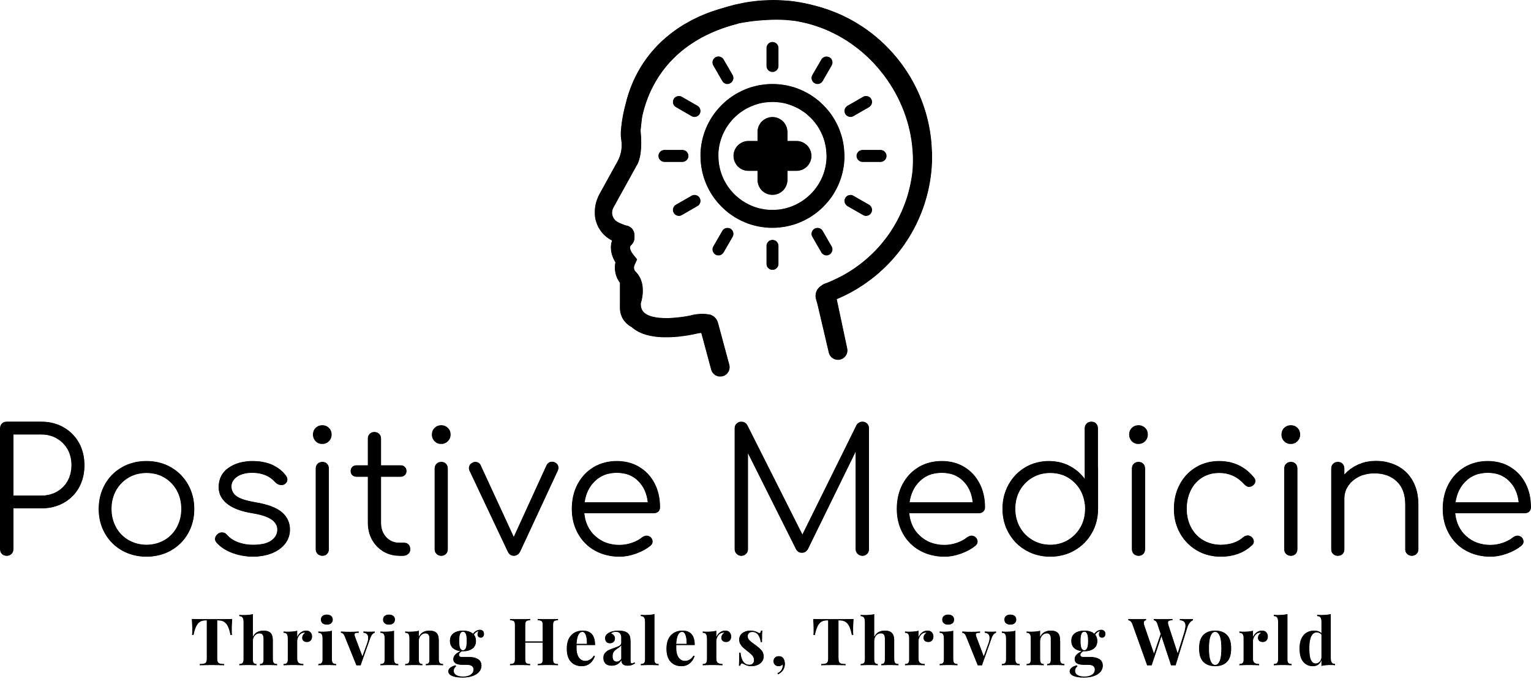
Disclosures
Jordyn Feingold receives royalties from Penguin Random House.
Jordyn Feingold provides consulting services for BetterUp, Inc. and the Center for Human Potential ©

Slide 3

Objectives
Dive into chief concerns of clinicians today
Examine a new construct of clinician well-being
Identify opportunities to incorporate
well-being principles into life as a clinician and human being

Slide 4

Things do not change; We change.
~ Henry David Thoreau

Slide 5
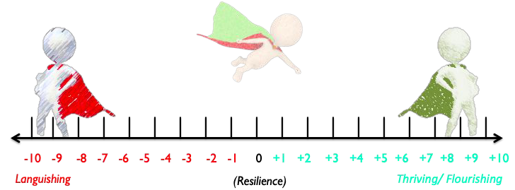
A Tale of Two Capes: Thought Experiment
From James Pawelski’s Positive Psychology Normative Analysis
If you could be superhero that could get rid of badness in the world (Red Cape), or one that could add goodness to the world (Green Cape), which would you choose and why?
Jordyn Feingold, MD, 2023; All Rights Reserved ©

Slide 6
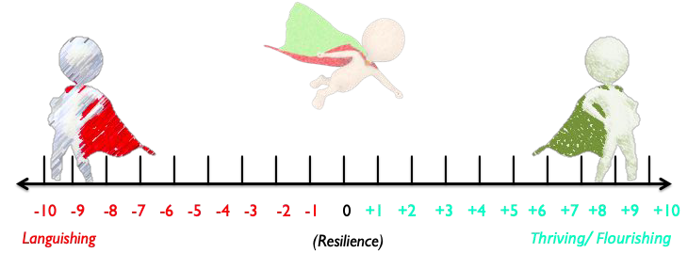
What might a Reversible Cape superhero look like?
Jordyn Feingold, MD, 2023; All Rights Reserved ©

Slide 7

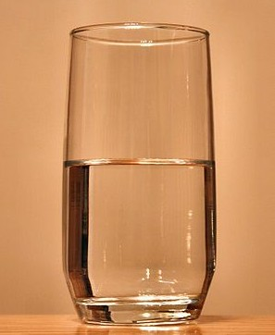
What do you see?

Slide 8

Positive Psychology
✚ The scientiﬁc study of human ﬂourishing and optimal human functioning… what is RIGHT with us!
✚ Empirically studies positive institutions, positive relationships, positive subjective states, character strengths, & virtues
Jordyn Feingold, MAPP 2020 ; All Rights Reserved ©

Slide 9
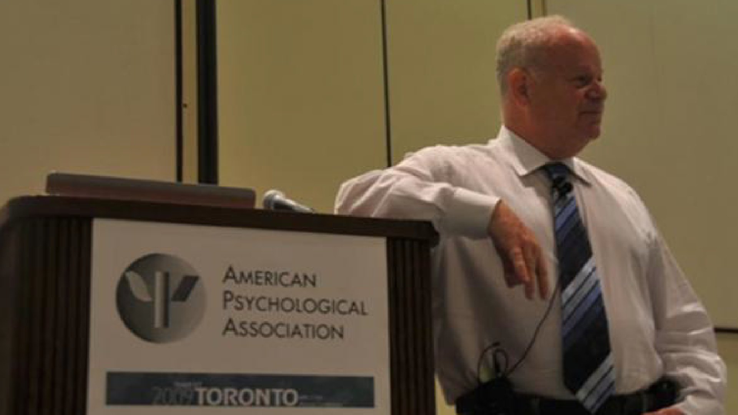
Positive Psychology
✚ Formally established in 1998 by Martin Seligman as the theme of his tenure as president of the American Psychological association
✚ Roots date back to ancient wisdom of the Greeks, Stoics, Buddhists, most recently the humanistic psychologists of the 20th century (Abraham Maslow, Karen Horney, Carl Rogers….)
Positive Psychology
✚ The scientiﬁc study of human ﬂourishing and optimal human functioning
✚ Positive institutions, positive relationships, positive subjective states, character strengths, & virtues
Jordyn Feingold, MAPP 2020 ; All Rights Reserved ©

Slide 10


Diagnosis: Burnout
As lives hang in the balance, the healthcare community is tackling emotional exhaustion within its ranks

Slide 11

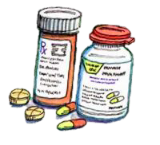
The “Medical Model”
× Emphasis on treating disease, rather than promoting health
× Putting patients ﬁrst, often before our own self-care
× Recapitulates and reinforces our vestigial negativity bias
× Heightened productivity demands + increasingly inefﬁcient
work environments
× Inadequate ﬁnancial training, debt, poor choices, loss of independence for clinicians
Jordyn Feingold, MD © Copyright 2023

Slide 12
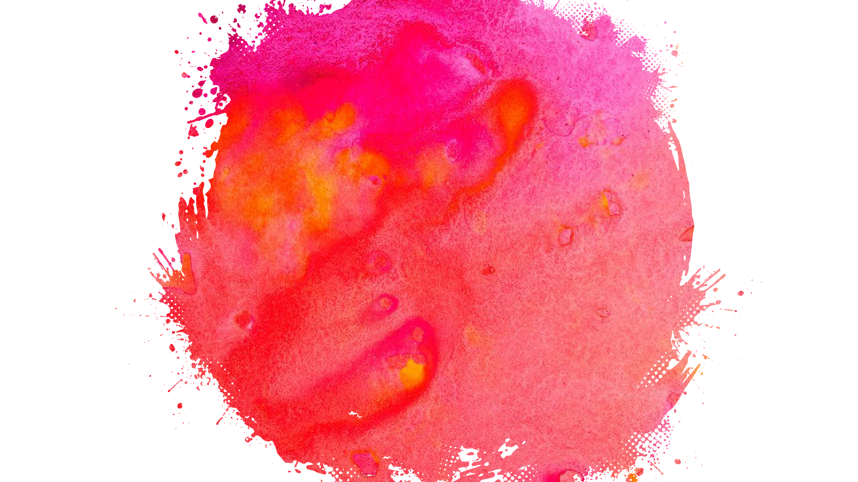
BURNOUT
❏ Emotional Exhaustion
❏ Depersonalization
❏ Low sense of personal accomplishment
Christina Maslach and colleagues.
Jordyn Feingold, MAPP © Copyright 2023

Slide 13
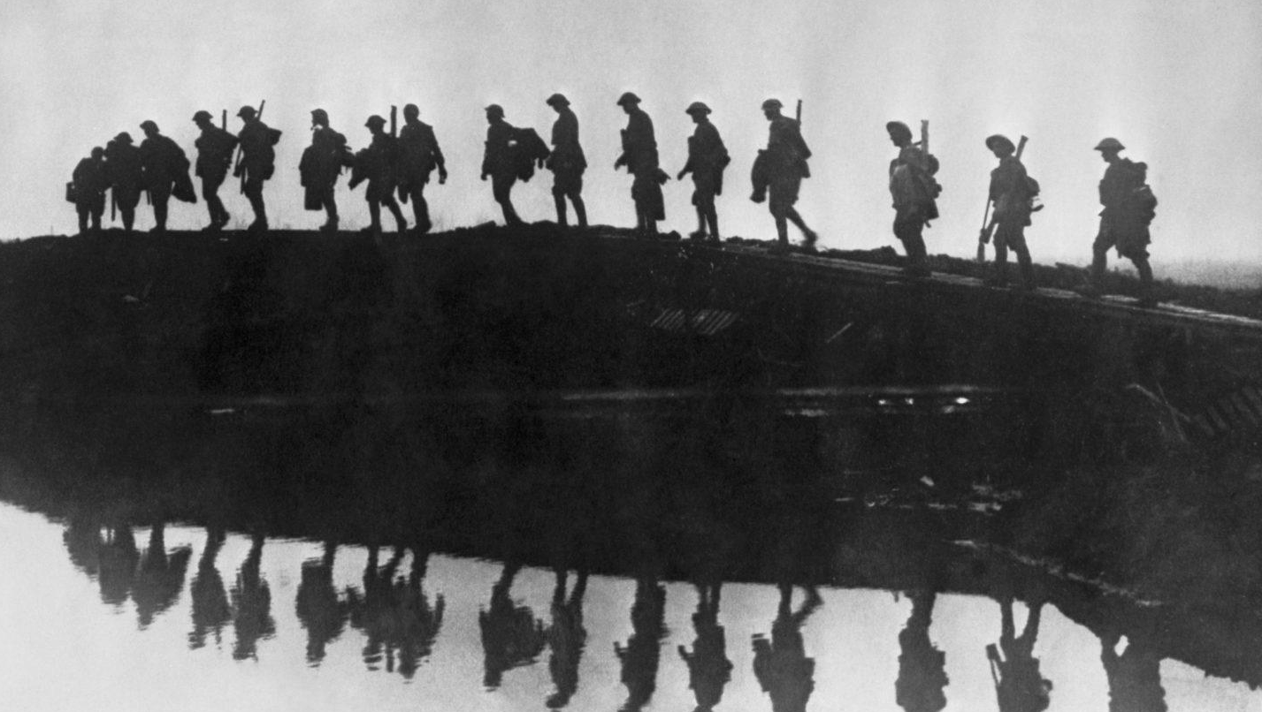
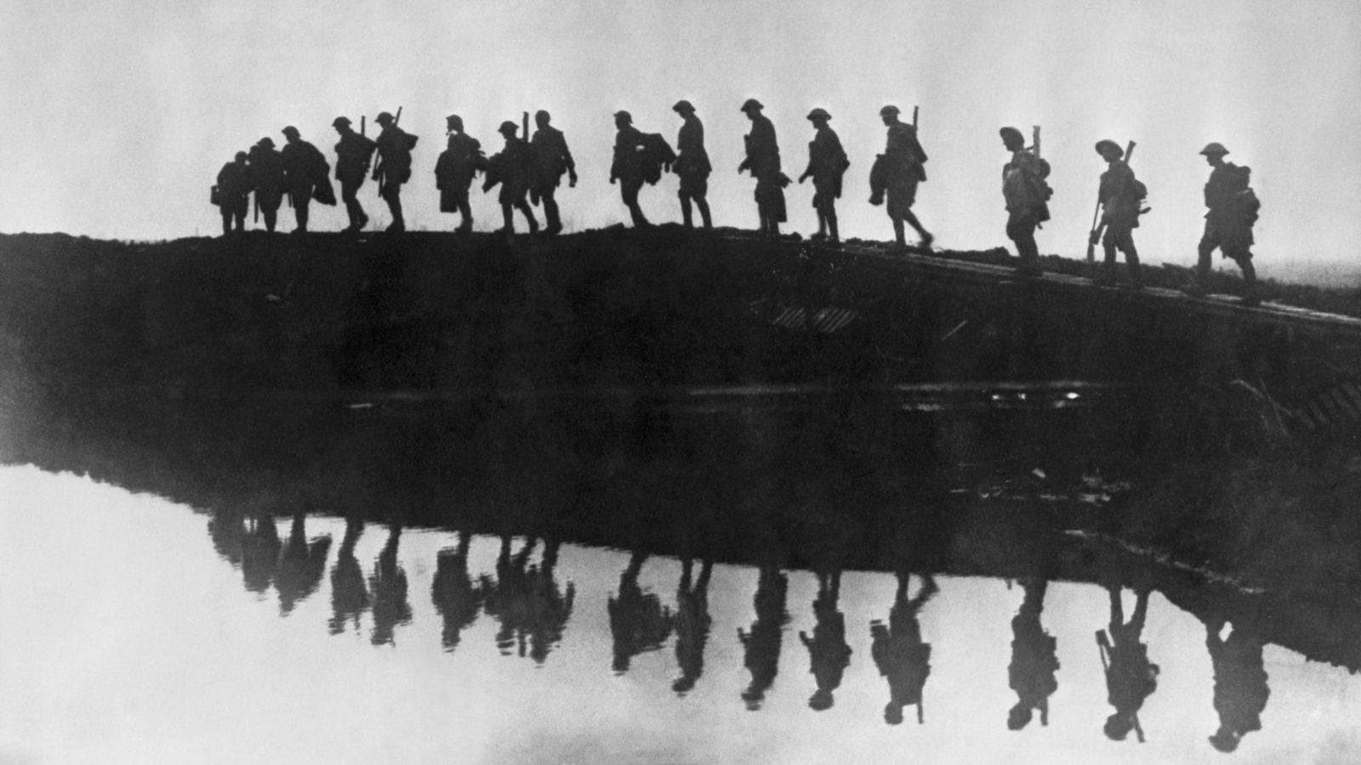
Moral Injury.
“A deep soul wound that pierces a person’s identity, sense of morality, and relationship to society.”
~Diane Silver
Supporting troops of the 1st Australian Division form a silhouette as they pass towards the front line in Belgium during the first World War. FRANK HURLEY/HULTON
ARCHIVE/GETTY IMAGES
Source: STAT. Physicians aren’t ‘burning out.’ They’re suffering from moral injury. By Simon G. Talbot and Wendy Dean | July 26, 2018

Slide 14
What we need is….
Leadership willing to acknowledge the human costs and moral injury of multiple competing
allegiances… who recognize that caring for their clinicians results in thoughtful,
compassionate care for patients, which ultimately is good business.
Senior doctors whose knowledge and skills transcend the next business cycle should be
treated with loyalty and not as a replaceable, depreciating asset…
We also need patients to ask what is best for their care and then to demand that their insurer
or hospital or health care system provide it without the best interest of the business entity
(insurer, hospital, health care system, or physician) overriding what is best for the patient.
A health care system aimed at creating a win-win where the wellness of patients correlates
with the wellness of providers.
~ Simon G. Talbot & Wendy Dean, 2018

Slide 15

“Despite the burgeoning research and practice in the realm of positive psychology, the notion of human ﬂourishing or optimal health is still mostly absent from medical practice. There exists no ﬁeld of “positive medicine,” that like positive psychology, would aim to cultivate a state of complete health and well-being, above and beyond the worthy goal of curing disease.
This missing piece of cultivating well-being holds immense promise for the healing and helping of many of our physicians who are currently languishing, as well as the patients whom they treat.”
-Jordyn Feingold, 2016

Slide 16
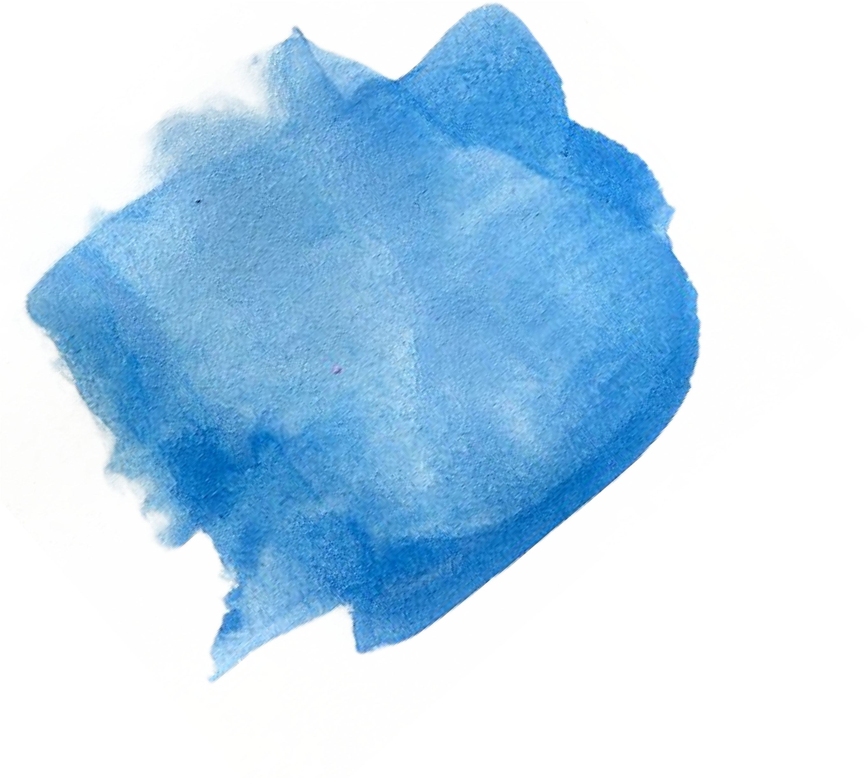




“Health is a state of complete positive physical, mental, and social
well-being, and not merely the absence of disease or inﬁrmity”
Preamble to the Constitution of the WHO, 1946
Why Positive Medicine?
“That physician will hardly be thought very careful of the health of his own patients if he neglects his own.”
- Galen, 130-200 AD
...“The demoralized person is preoccupied with merely trying to survive.”
- Frank & Frank, 1991, Persuasion and Healing
Jordyn Feingold, MD © Copyright 2021

Slide 17

Positive Medicine
A deliberate and balanced approach to medicine that centers physician well-being as central to optimal patient care delivery
Recognizes that the absence of disease ≠ health
Equips medical professionals with an evidence-based path forward for living healthier, happier lives; on par with an in service to patient care
Positions medicine as a ﬁeld that aims to not just cure disease, but to promote the thriving of our population
Jordyn Feingold, MD © Copyright 2021

Slide 18


A Paradigm Shift
Self-care IS NOT selﬁsh; IT IS a MUST for self and your visions
Well-being and resilience can be learned & developed
Positive Interventions can help us get there
Jordyn Feingold, MD © Copyright 2021

Slide 19

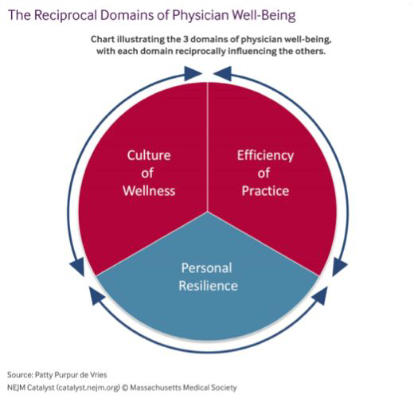

Slide 20
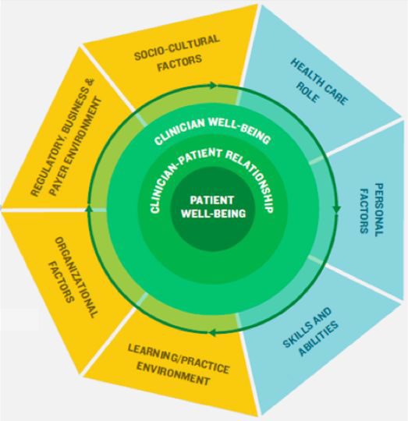
National Academy of Medicine Action Collaborative on Establishing Clinician Well-Being and Resilience

Slide 21

Jahoda,
lshizuka,
1988°
1. The Search for Self
Ryff,
1989iii
Seligman,
2011iv
1. Positive Emotion
Huppert & So,
2013v
Prilleltensky et al, 2015vi
1958i
1. Positive Attitude Toward
Self
1. Self-Acceptance
l. Competence
I.Psychological
Personal Growth
Integration of Psycholog;iical Function
Autonomy
Accurate Perception of Realiey
2a. The Need for Intimacy (w/ people) 2b. The Need for Intimacy [w/universe)
3. The Quest for Achievement
Positive Relationships
. Autonomy
Engagement
Positive Relationships
Meaning
2. Emotional Stability
2. Community
3. Engagement
3. Interpersonal
Environmental Mastery
Purpose in Life
4. Meaning
4. Occupational
5. Accomplishment
5. Optimism
5. Economic
6. Environmental Mastery
6. Personal Growth
6. Positive Emotion
6. Physical
Positive Relationships
Resilience
Sociological construct of well­ being; not directly
,compared to other Psychological
constructs
Relationship with the self
■
■
Posit.-·e en.o
u &. • eg11.ation
Relationships
with others
Physical Health/Vitality
En
mer
an
Per ondl Growth
1 .- .
..,su holugicaJ J':"ieasures
9. Self-esteem
Competence/ Achievement
Elements Across 6 Theories of Well-Being (Feingold, 2016)

Slide 22

Six ingredients that comprise well-being…
Relationships ~ Engagement ~ Vitality ~ Accomplishment ~ Meaning ~ Positive Emotions
22
Jordyn Feingold, MD © Copyright 2023

Slide 23

R
E V A M P
23
Jordyn Feingold, MD © Copyright 2021

Slide 24
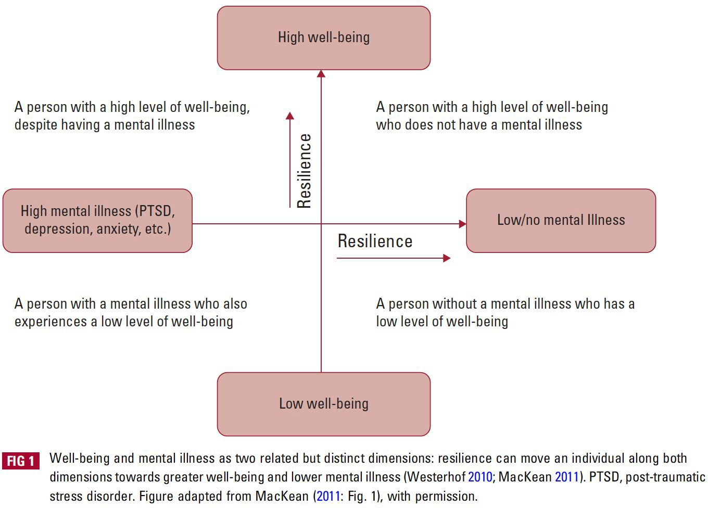
The presence of well-being is not merely the same as the absence of a mental illness… These are two related, orthogonal, but not identical constructs.
Jordyn Feingold, MD © Copyright 2023

Slide 25
So what is “mental health” or positive “mental health” anyway?
REVAMP Model x Nancy McWilliams’ 16 Elements
Relationships | Engagement | Vitality | Accomplishment | Meaning | [Positive] Emotions
The ability to love (without idealization or devaluation) Safe relationships (secure attachment) | The ability to work (to create what is valuable to a person, family, society) | The ability to play (dance, sing, play sports) Ability to be and feel alive | Autonomy (ability to choose our path) Acceptance of what cannot be changed | A system of values orientation (morals, organizing principles) Balance of self & environment (healthy selﬁshness) | The ability to adapt and recover from stress (ego strength) Ability to endure the heat of emotions (feeling while engaging thoughts)
Coherent self-concept (integration of all sides of the self) | Realistic and reliable self-assessment (stable self-esteem) | Reﬂective capacity (ability to remain ego-dystonic) | Mentalization (seeing others as other) | wide variety of protective mechanisms & ﬂexibility Jordyn Feingold, MD © Copyright 2023

Slide 26

RELATIONSHIPS
→ The single most important source of life satisfaction & emotional well-being
Close interpersonal relationships
Workplace relationships (colleagues, peers, supervisors) Relationship with the self (self-compassion)
Jordyn Feingold, MD © Copyright 2023

Slide 27
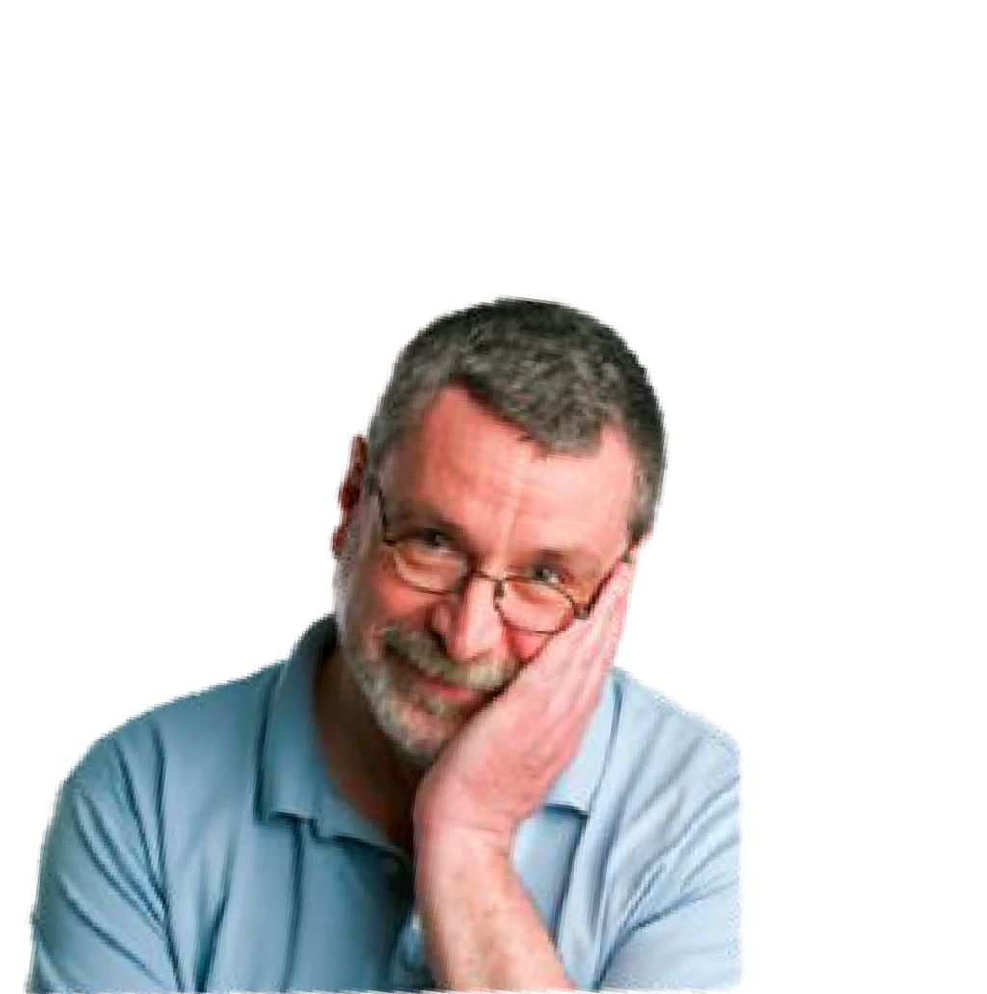
Positive Psychology in 3 words:
“Other People Matter”
~Christopher Peterson

Slide 28
Relationships Matter. A lot.
In a meta-analysis looking at 148 studies of more than 300,000 people worldwide, individuals who had ample social connections had between 50-91% greater survival rates than those with meager connections.
Meager connections equaled the effect of smoking 15 cigarettes a day or being alcohol dependent, and doubled the effect of not exercising or being obese, indicating that social relationship factors may be just as important to treat as are risk factors for smoking, diet, and exercise
(Holt-Lunstad, Smith, & Layton, 2010; Joseph, 2015).
Individuals with close relationships with friends, family, co-workers, members of a church, or other support groups are less likely to die prematurely than those with fewer social ties
(Cohen, 1988; House, Landis, & Umberson, 1988; Joseph, 2015).

Slide 29
Relationships & Health
Over 50 studies have revealed that social support lowers blood pressure & stress hormones, and buffers immune functioning (Cohen, Doyle, Skoner, Rabin, & Gwaltney, 1997).
Positive, happy, and supportive marriages have been shown to be conducive to health by improving the quality and length of life (Wilson & Oswald, 2005; Kiecolt-Glaser & Newton, 2001).
In a 70-year-long study conducted at Harvard, researchers found that a good marriage at age 50 predicts aging better than low cholesterol level at 50 (Valliant, 2002).

Slide 30
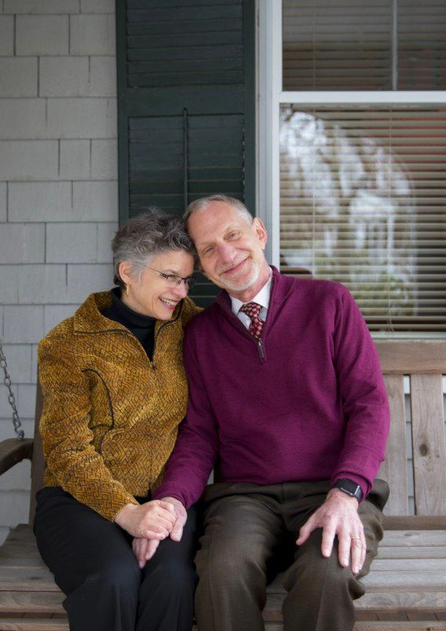
Harvard Longevity Study
“Close relationships, more than money or fame, are what keep people happy throughout their lives. Those ties protect people from life’s discontents, help to delay mental and physical decline, and are better predictors of long and happy lives than social class, IQ, or even genes.”

Slide 31
[Workplace] Relationships & Health
Studies reveal that bad relationships are detrimental to health. (Barr, Sutton, Simons, Wickrama, & Lorenz, 2016). Bad relationships subtract from our well-being more than good friends add to our well-being (Hartup & Stevens, 1997).
If you believe you have emotional support in the workplace you are 2.4 times more likely to live (over a 20 yr period) than people who do not have emotional support (Shirom, Toker, Alkalay, Jacobsen and Balicer, 2011)

Slide 32
Building relationships (at work)
“Many of us strive for a meaningful job, an impressive title, or a sizable salary at the ideal company. In doing so, we drastically undervalue the importance of relationships, even though extensive research shows that it’s people, not the perfect job, that lead to fulﬁllment.”
But how can we build meaningful relationships in such a busy and/or “professional” environment?
SOURCE: https://hbr.org/2019/07/to-be-happier-at-work-invest-more-in-your-relationships

Slide 33
Barriers to connecting at work
Not enough time!
Workplace is too transactional!
“My colleagues just don’t seem interested”
Everything I’ve tried is just painful!
“Mixers/social events are awkward”
“I just want to get done so I can hang out with my friends and family”
“I just talk with the same people I always do”
“Everyone is focused on setting themselves up for the next step”
“I’m only on this service for 2 weeks…”
“Icebreakers :(“
Friendships ARE important for professional success!
↑ effectiveness, ↑ decision-making, ↑ cooperation
Jehn, K. A., & Shah, P. P. (1997). Interpersonal relationships and task performance: An examination of mediation processes in friendship and acquaintance groups. Journal of
Personality and Social Psychology, 72(4), 775–790.
Chiaburu, D. S., & Harrison, D. A. (2008). Do peers make the place? Conceptual synthesis and meta-analysis of coworker effects on perceptions, attitudes, OCBs, and performance.
Journal of Applied Psychology, 93(5), 1082–1103.

Slide 34
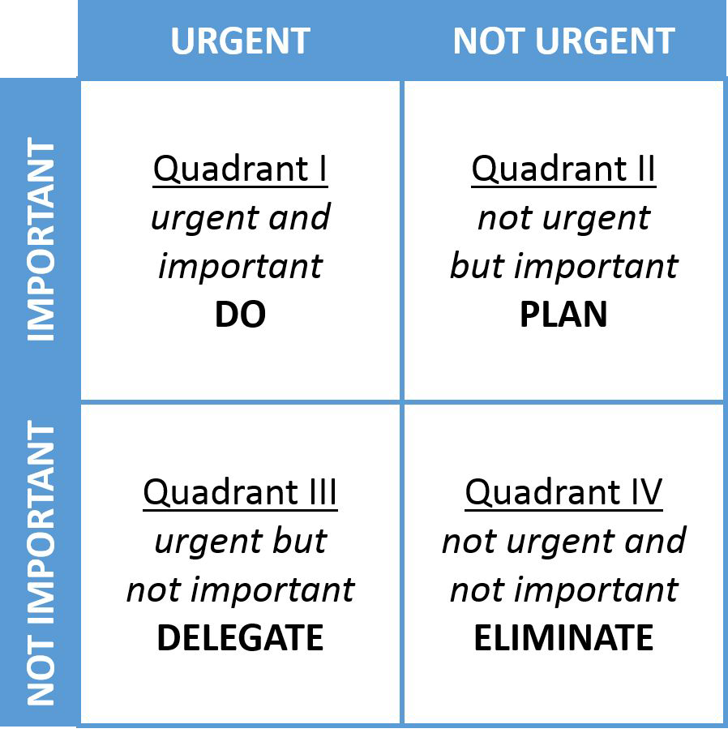




We focus much of our lives in quadrant III
Relationships:
Usually fall into quadrant II
Until they fall in quadrant I… and we often can’t form relationships urgently
Eisenhower Matrix
SOURCE: McKay; Brett; Kate (October 23, 2013). "The Eisenhower Decision Matrix: How to Distinguish Between Urgent and Important Tasks and Make Real Progress in Your Life".

Slide 35
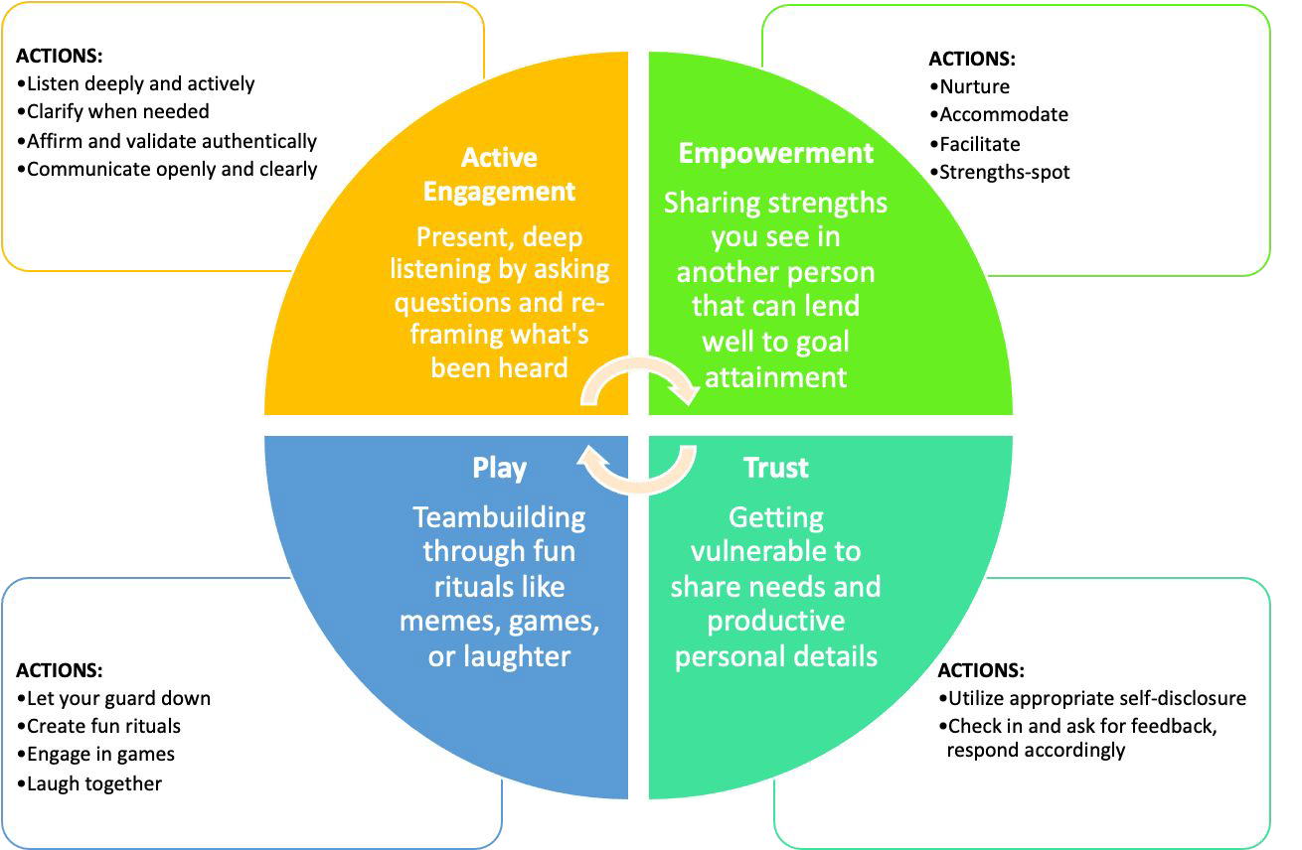
High Quality Connections (Jane Dutton)

Slide 36
Active Constructive Responding
ACR = Building trust and connection
through sharing another’s joy
“Will you be there for me when things go right?”
Gable, S. L., Reis, H. T., Impett, E. A., & Asher, E. R. (2004). What do you do when things go right? The intrapersonal and interpersonal benefits of sharing positive events. Journal of Personality and Social Psychology, 87(2), 228– 45;

Slide 37
Response Styles - Demonstration
Active-Destructive: Demeaning the event THE KILLJOY | Active-Constructive: Enthusiastic support, asking questions THE CAPITALIZER
Passive-Destructive: Ignoring the event, shift focus to the self THE ONE-UPPER | Passive-Constructive: Quiet, understated support THE BUZZKILL

Slide 38
Active-Destructive:
Active-Constructive:
Enthusiastic support, asking questions
THE CAPITALIZER
AUTHENTIC INTEREST, VALIDATION, UNDERSTANDING;
STRENGTHENS RELATIONSHIPS
Demeaning the event
THE KILLJOY
FOCUS ON THE NEGATIVE, EMBARRASSMENT, GUILT
Passive-Destructive:
Ignoring the event, shift focus to self
THE ONE-UPPER
CO-OPT THE CONVERSATION, CONFUSION
Passive-Constructive:
Quiet, understated support
THE BUZZKILL
THE MOST LETHAL TO RELATIONSHIPS

Slide 39
Your friend gets a raise…..
Active-Destructive: “Isn’t that new role going to make you even more stressed than you already are? | Active-Constructive: “That’s wonderful! Tell me everything from start to ﬁnish. Who told you? What did they say? How do you feel?”
Passive-Destructive: “That reminds me; Jessica was accepted to Medical School!” | Passive-Constructive: “I’m happy for you… I really gotta get back to work.”

Slide 40
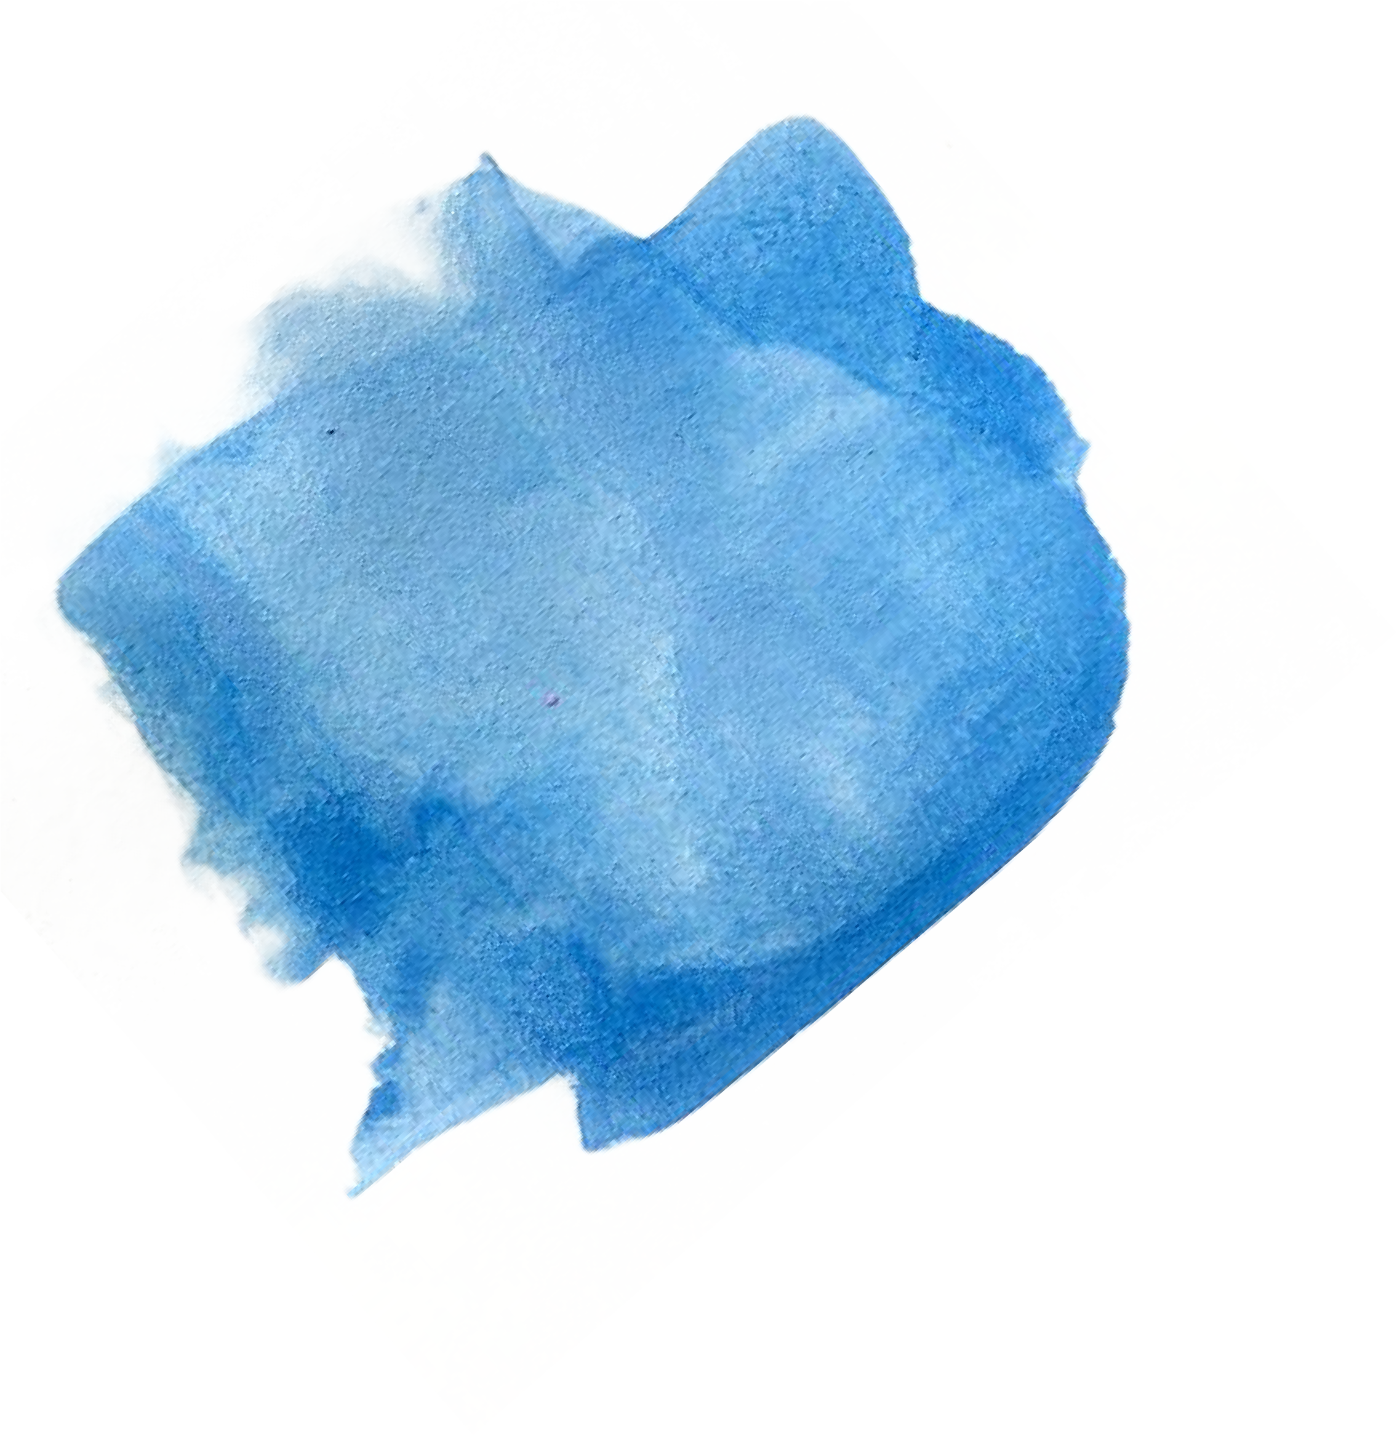
No BUTS.
“When someone relates good news, respond without using the word but. Also don’t use any of its close cousins, like however, whereas, yet, then again, and on the other hand.”
From: Peterson (2013). Pursuing the Good Life: 100 Reﬂections on Positive Psychology

Slide 41

ENGAGEMENT
→ Optimizing immersion in daily life, showing up as our best
Flow
Character strengths Mindfulness
Jordyn Feingold, MD © Copyright 2023

Slide 42

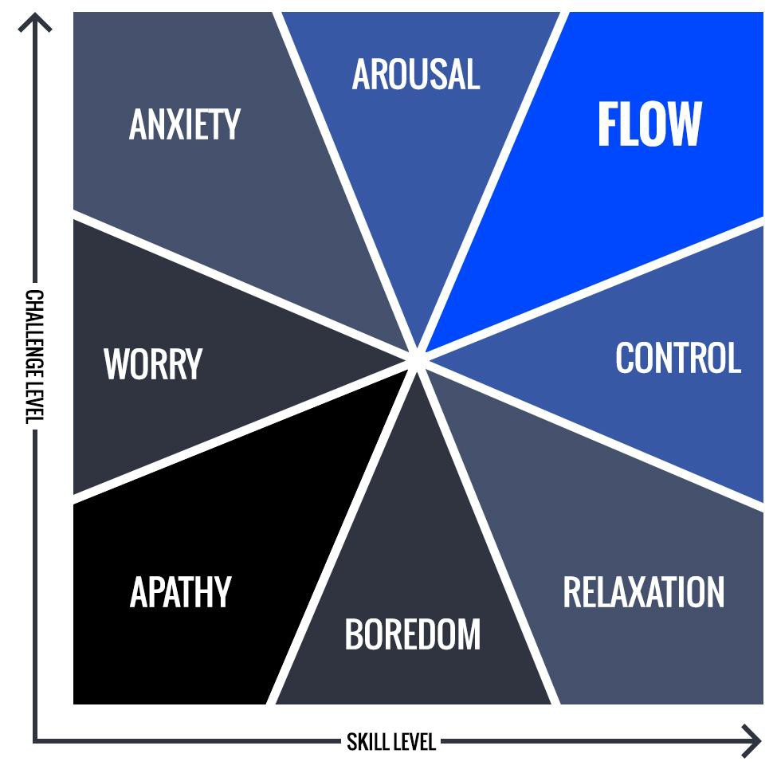
FLOW and the unitary continuum
Peak experiences
42

Slide 43
Flow Characteristics
Merging of action and awareness
Complete absorption in the task at hand
Lack of worry about losing control *Paradoxically leads to gaining control
Loss of self-consciousness
Time moves in unordinary ways
Autotelic nature of the experience
Skill + challenge are optimally matched
Clear goals + immediate feedback *Symbolic feedback
Csikszentmihalyi, M. (1990). Flow: The psychology of optimal experience. New York: Harper Perennial.

Slide 44
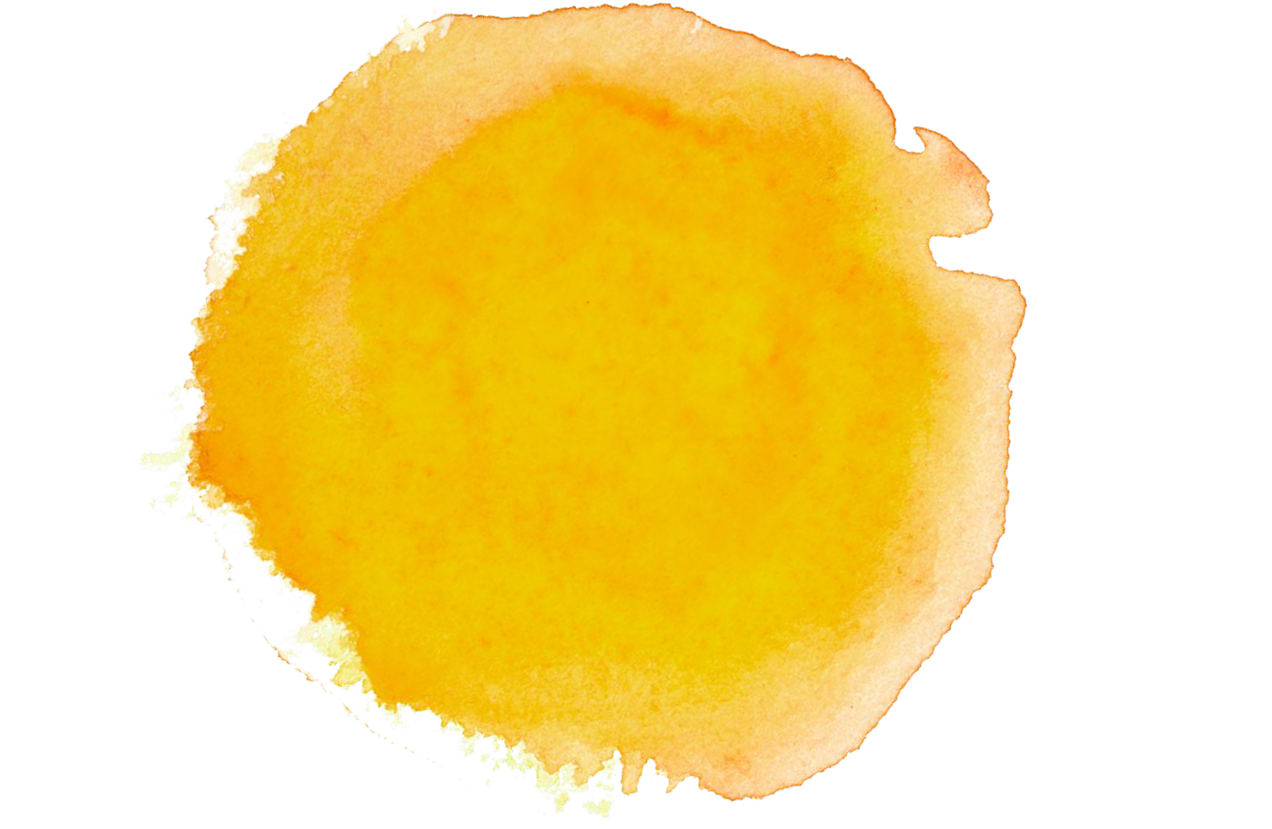
What activity were you doing the last time you experienced ﬂow?

Slide 45
How might we foster more ﬂow at work?

Slide 46

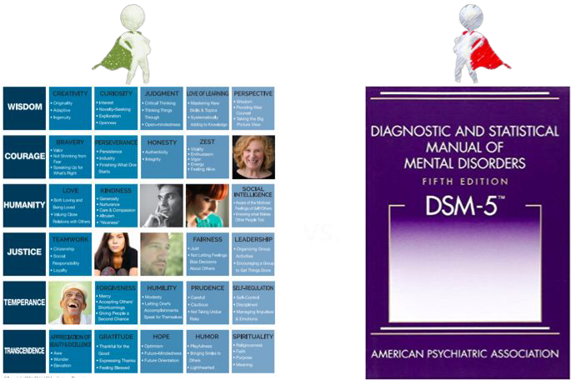
Strengths
Character

Slide 47
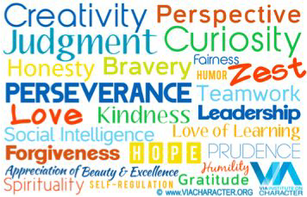
Signature Strengths
Your TOP strengths
Make you YOU
Intrinsically motivated
Help you feel energized
Call upon them in times of challenge
Associated with life satisfaction
Can help increase lower strengths
Can be developed!
Niemiec, R. M. (2013). VIA character strengths: Research and practice (The first 10 years). In H. H. Knoop & A. Delle Fave (Eds.), Well-being and cultures: Perspectives on positive psychology (pp. 11-30). New York, NY: Springer.

Slide 48
Uncover Yours!
Visit → www.viacharacter.org
Register to take the assessment (240 question item Adult Survey)
Review your results
Use your top strengths in new ways!

Slide 49

What if….
You could take a pill that is proven to reduce the risk of heart attacks/stroke/and death by 49%, signiﬁcantly reduce blood pressure, rates of anxiety/depression, and substance abuse; statistically improve academic performance, creativity, and the length/quality of life.
Holzel, Britta et al. (2011). Mindfulness Practice leads to increases in regional grey matter density. Psychiatry Research:Neuroimaging 191

Slide 50

Mindfulness
The awareness that emerges Through paying attention on purpose
In the present moment & non-judgmentally to
The unfolding of experience moment by moment
~Jon Kabat-Zinn

Slide 51

The Power of the Breath
Brain is our reality
We breathe 22,000 times per day…how many of these breaths are we aware of??
Our breathing both reﬂects and ampliﬁes our emotions
~Danny Penman “The Art of Breathing”
MIND (thinks a thought)
BODY (feels an emotion)
BREATH (reﬂects the emotion)

Slide 52
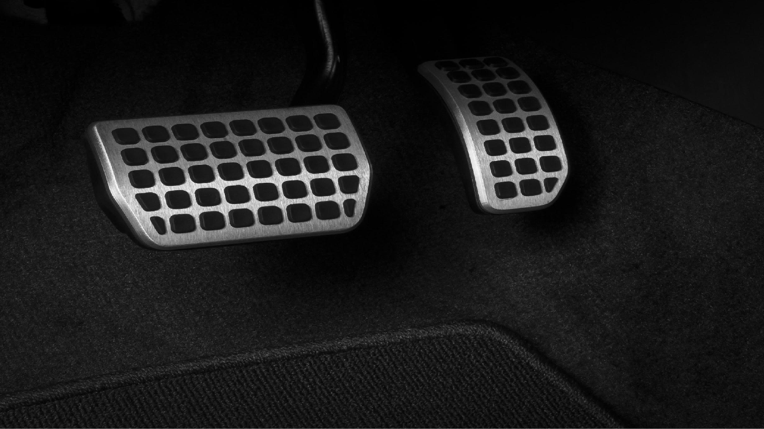
Parasympathetic Nervous System Rest & Restore
Sympathetic Nervous System Fight or Flight

Slide 53

Mindful STOP
S ~ Stop several times throughout your day
T ~ Take a few breaths – where is my breath?
Chest or belly?
O ~ OBSERVE “Am I fully awake?” Do I know what I am doing right now? How does my body feel right now? Is there anything I can release i.e. held tension in the body. What is my attitude/perspective and can/should it shift and reframe in a different light?”
P ~ Proceed with greater clarity and focus

Slide 54

VITALITY
→ Unpacking the mind-body; possessing the energy to complete tasks with vigor
Physical Activity
Diet Sleep Mindsets
Jordyn Feingold, MAPP 2020 ; All Rights Reserved ©

Slide 55


If you’re in a bad mood, go for a walk.
If you’re still in a bad mood, go for another walk.
~Hippocrates

Slide 56

Beneﬁts of Physical Acticity
Life satisfaction (Stubbe, de Moor, Boomsma, & de Geus, 2007).
Executive Function, Working Memory (Kramer et al., 1999; Colcombe & Kramer, 2003)
Improved Reaction Time, Information Processing, Decision-Making (Suominen-Troyer, Davis, Ismail, & Salvendy, 1986; Chang & Itnier, 2009)
Cognitive ﬂexibility (Coles & Tomporowski, 2008; Sibley & Beilock, 2007; Winter et al., 2007; Netz, Tomer, Axelrad, Argov, & Inbar, 2007)
Improved Visuospatial Memory + Positive Mood (Stroth, Hille, Spitzer, & Reinhardt, 2009)

Slide 57

Brain-Derived Neurotrophic Factor [BDNF]
MiracleGro for the brain! Enhances & maintains neural circuitry
(Ratey & Hagerman, 2008)
Considered the link biological link between movement, thoughts, emotions; may increase capacity to learn
Inversely correlated with depression, emotional exhaustion; Positively correlated with feelings of competence (Sertoz et al., 2008)
Exercise increases BDNFs
Beneﬁts of exercise last several weeks in animal models (Berchtold, Castello, & Cotman, 2010)
Acute exercise increase blood serum BDNF levels in humans (Ferris, Williams, & Shen, 2007)

Slide 58

The human genome evolved to support metabolic demands associated with hunting and foraging for food; when physical activity was critical for survival;
Thus, our optimal cognitive ﬁtness depended on our physical ﬁtness (Ratey & Loehr, 2011)

Slide 59
Clinicians who regularly perform aerobic exercise and/ or strength training are more likely to council their patients regarding the important beneﬁts of exercise
(Abramson, Stein, Schaufele, Frates, & Rogan, 2000)

Slide 60

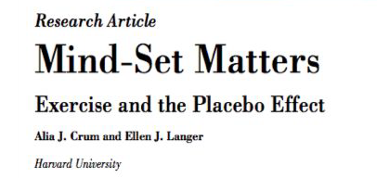
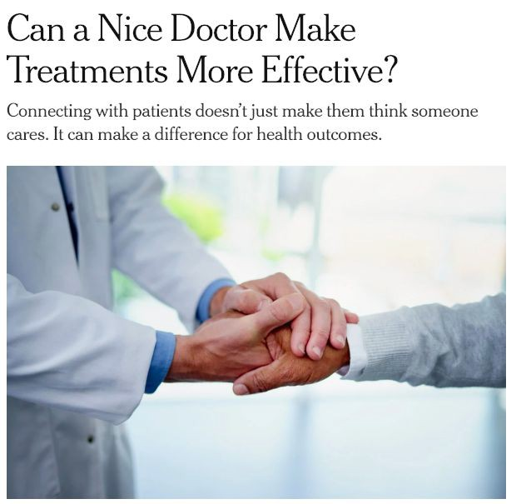
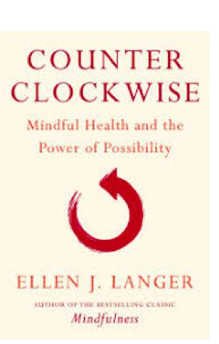
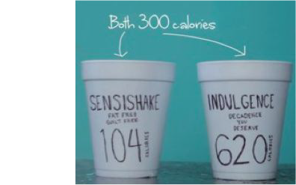
Mind over matter.

Slide 61
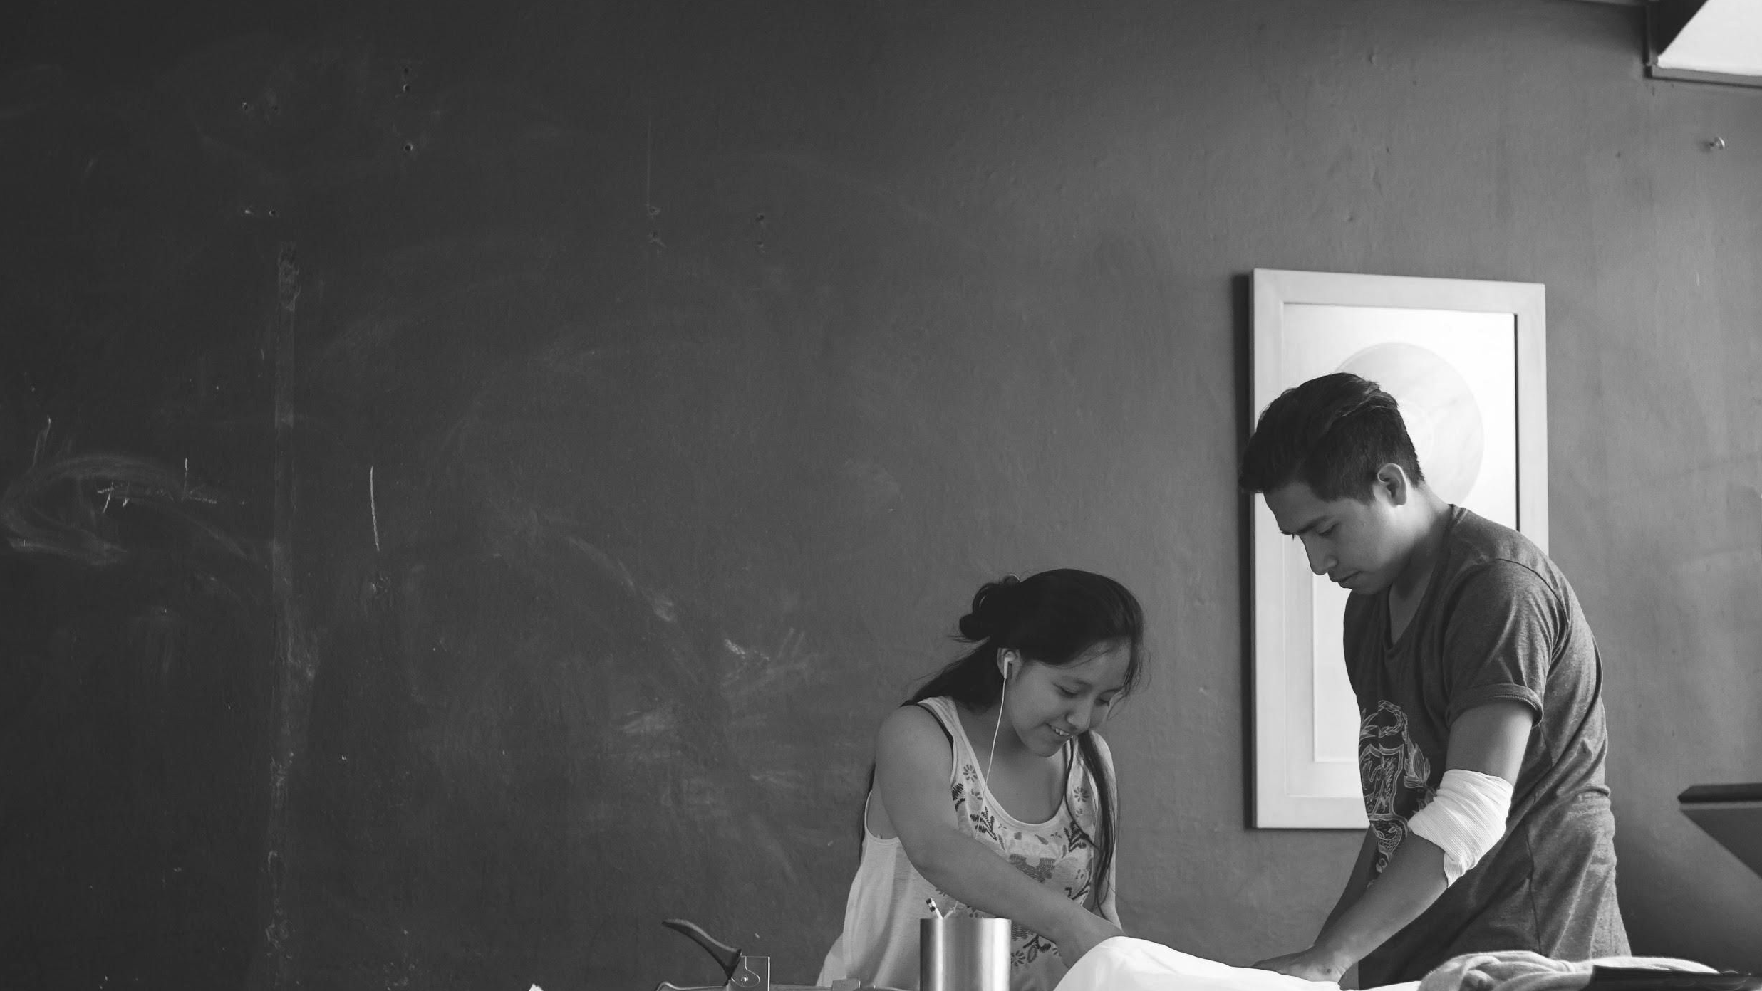
ACCOMPLISHMENT
→ Success ≠ a zero sum game
Grit
“Otherishness” Goal-setting
Jordyn Feingold, MAPP 2020 ; All Rights Reserved ©
Photo by jose aljovin on Unsplash

Slide 62
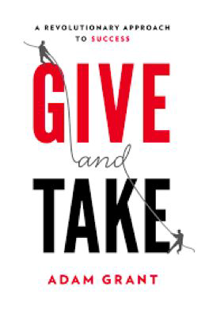
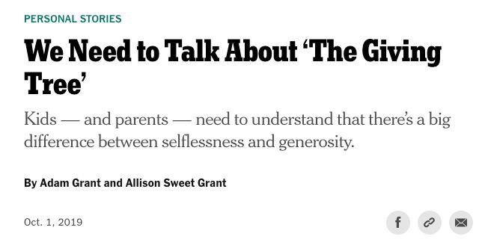
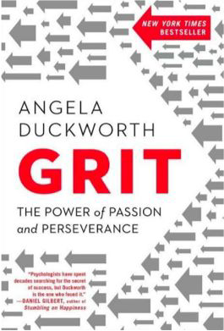
Gritty Otherishness
+

Slide 63

POSITIVE ACCOMPLISHMENT =
Grit + Otherishness
GRIT = passion and perseverance for long-term goals, deﬁned by sustained interest
and effort over time
(Duckworth, Peterson, Matthews, & Kelly, 2007).
OTHERISHNESS = successfully working toward one’s own personal goals while
focusing on helping others.
(Grant, 2013, p. 158; Rebele, 2015).
Jordyn Feingold, MAPP © Copyright 2020

Slide 64

Positive Accomplishment
Success ≠ a zero sum game
❏ Prioritize your own needs and goals
❏ Be a ‘chunker’ not a sprinkler
❏ Know when to say NO
❏ Ask for help more often and more efﬁciently
❏ Seize energizing opportunities to help
❏ Reﬂect on your impact
❏ Build a team
(Grant, 2013, Rebele 2015)
Jordyn Feingold, MAPP © Copyright 2020
Photo by jose aljovin on Unsplash

Slide 65

Hedonic Adaptation!
× We adapt to both positive and negative stimuli that are constant
(Brickman, 1978)
× Nature doesn’t care that we are happy.
× We adapt to:
× Marriage (Kahneman & Kruger, 2006)
× Divorce (Lucas, 2005)
× Death of a spouse (Clark, Deiner, et al., 2008)
× Getting ﬁred (Di Tella et al., 2007)

Slide 66

SMART Goals
SPECIFIC
MEASURABLE
ACHIEVABLE
RELEVANT TO LARGER GOALS
TIME-LIMITED
Jordyn Feingold, MAPP © Copyright 2020

Slide 67

MEANING
→Belonging to and serving something larger than the self
Connecting with your purpose, calling (Ikigai)
Posttraumatic Growth Living by your values
Jordyn Feingold, MAPP 2020 ; All Rights Reserved ©

Slide 68


To whom do I matter? What matters to me?
How do I live my life in line with what matters?

Slide 69

Beyond Happiness (Emily Esfahani Smith)
Sense of belonging - relationships in which we are valued and understood
Purpose - spending time in a worthwhile way, making a contribution to others (living by values)
Transcendence - connecting with everything, feeling the ego fade away
Storytelling - telling a narrative of our own lives, how we became us; helping others own their narratives
Esfahani Smith, E. (2017). The power of meaning: Finding fulfillment in a world obsessed with happiness. New York: Penguin Random House. ISBN 9780553446555

Slide 70

What gives my
life purpose?

Slide 71


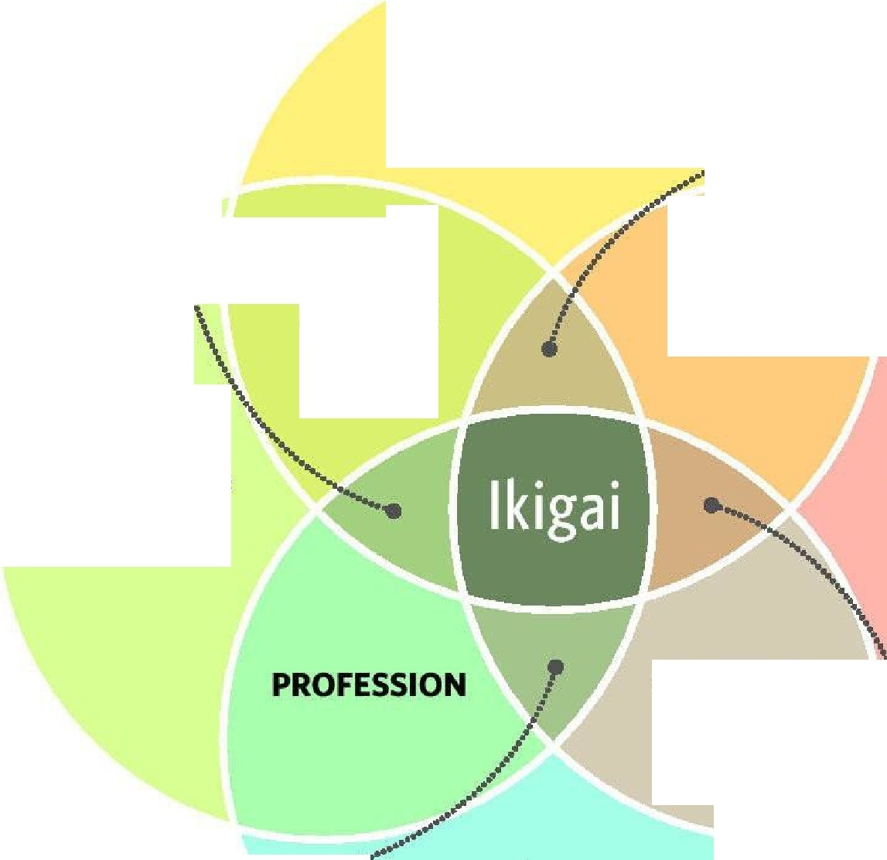
lkigai
A JAPANESECONCEPT MEANING "A REASON FOR BEING"
What you
LOVE
I
Satisfaction, but feeling of .
uselessness \
I
Delight and
,..........- ....---"""" fullness, but
••••••
no wealth
\
\
\
PASSION
MISSION
What you are
GOOD AT
What the world NEEDS
VOCATION
\
\
\
'I
I
\
'
Comfortable, !"""" .................-·· but feeling of
emptiness
What you can be PAID FOR
Excitement and complacency, but sense of uncertainty
SOURCE: dreamstime
TORONTO STAR GRAPHIC

Slide 72
Honor | Creativity | Calm | Citizenship
Wisdom | Forgiveness | Magic | Belonging
Integrity | Intuition | Wonder | Flow
Peace | Compassion | Humor | Structure
Beauty | Diversity | Organization | Rhythm
Nesting | Experience | Stability | Excitement
Nurturance | Learning | Security | Wit
Balance | Loyalty | Understanding | Sustainability
Faith | Reliability | Intelligence | Self-sufﬁciency
Spirituality | Order | Adventure | Independence
Love | Respect | Risk | Interdependence
Strength | Thoughtfulness | Courage | Leadership
Communication | Patience | Power | Transcendence
Self-expression | Tolerance | Connectedness
Imagination
Attentiveness
Curiosity
Equality
Perseverance
Caring
Serenity
Intimacy
Simplicity
Sensuality
Spontaneity
Play
Comfort
Fun
Warmth
Effort
Discipline
Productivity
Justice
Health
Kindness
Fitness
Expansiveness
Freedom
Strength
Openness

Slide 73

"In some ways, suffering ceases to be suffering at the moment it ﬁnds a meaning."
~Victor Frankl

Slide 74
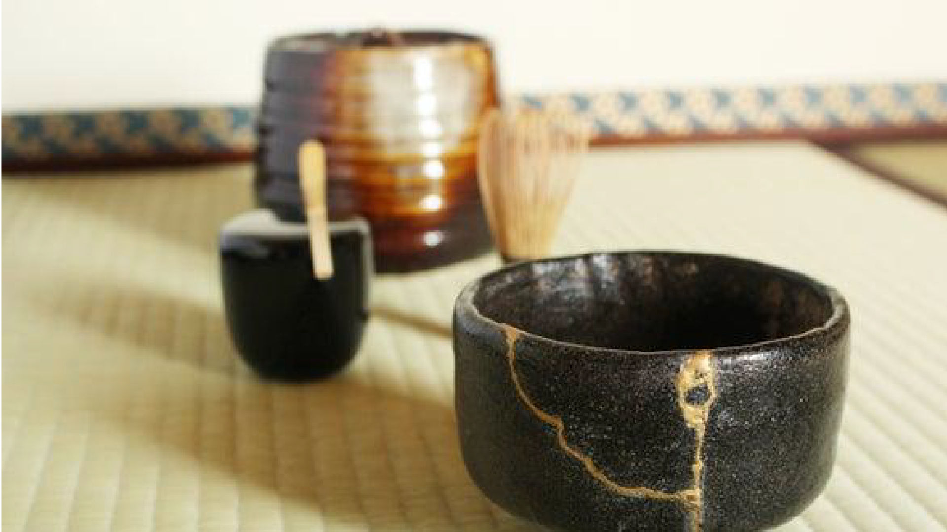
Kintsugi Pottery

Slide 75
Posttraumatic Growth (PTG)
Positive psychological changes that may develop as a consequence of highly challenging life circumstances
Linked to improved functioning & resilience to subsequent trauma
  Deeper interpersonal relationships
  Greater sense of personal strengths
  Openness to new possibilities for one’s life
  Stronger sense of spirituality
  Enhanced appreciation of life
  Enhanced altruism and compassion
  Creative growth
Tedeschi R, Calhoun L. Target article: posttraumatic growth. Psychological Inquiry. 2004;15(1):1-18.

Slide 76

POSITIVE EMOTIONS
→ Embracing a mindset of positivity & Feeling GOOD
Expanded Attention (“Broaden-and-build”)
Resilience Savoring
Jordyn Feingold, MAPP 2020 ; All Rights Reserved ©
Photo by Court Prather on Unsplash

Slide 77

gratitude
Joy
serenity
interest
hope
pride
amusement
inspiration
awe
love
Photo by Lidya Nada on Unsplash

Slide 78

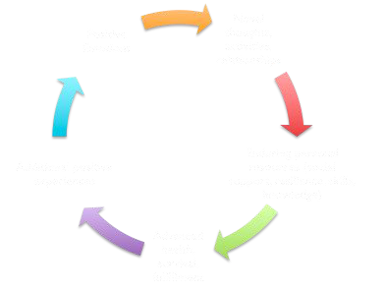
POSITIVE EMOTIONS
(Barbara Fredrickson)

Slide 79
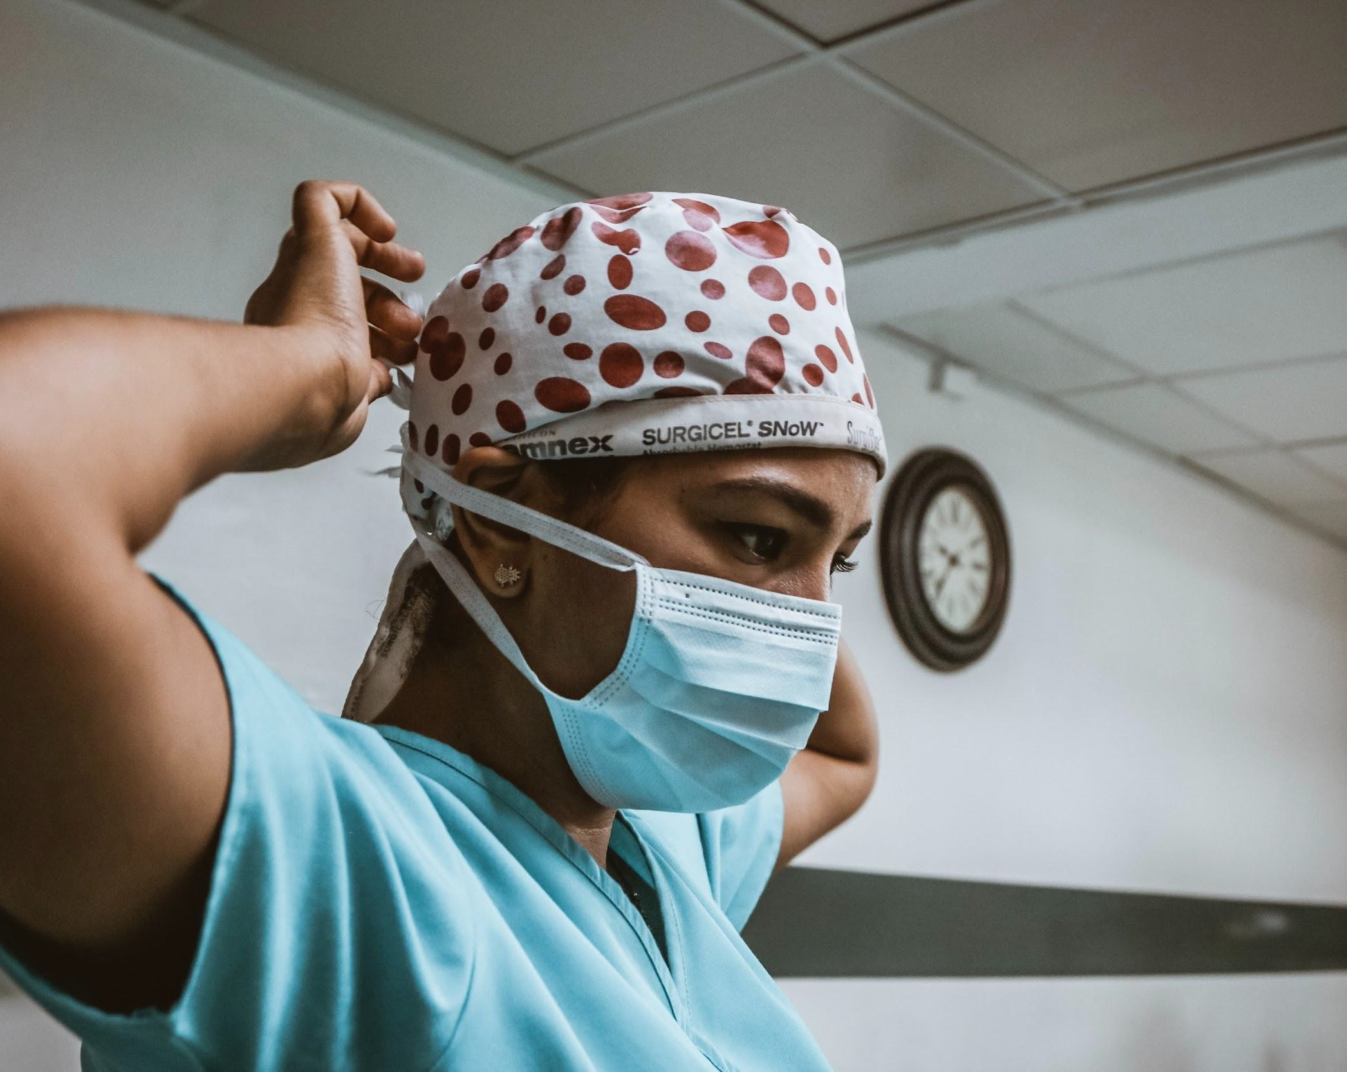
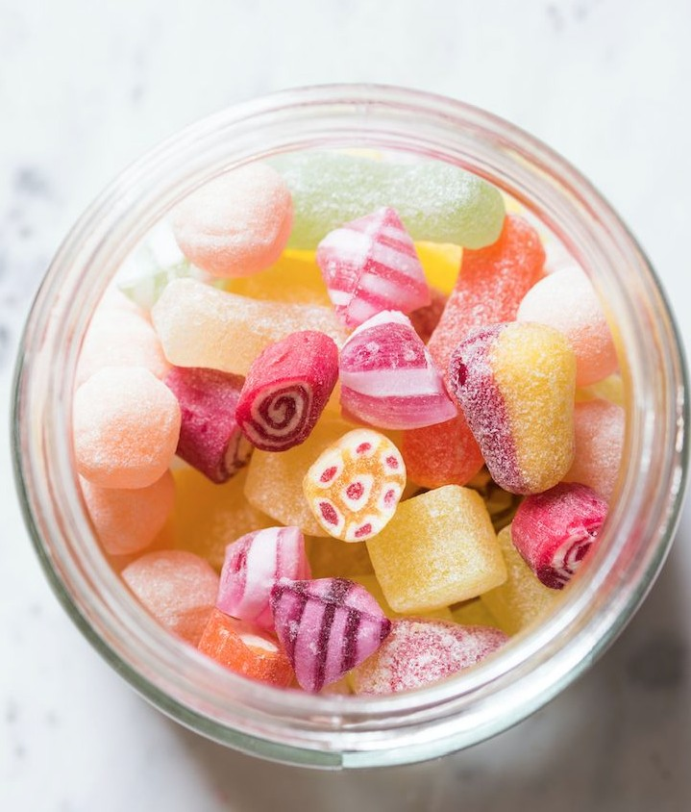
Physicians who were induced with positive emotions before seeing their patients were actually better than their control counterparts at integrating patient case information.
Positively induced doctors were less likely to become ﬁxated on initial ideas and come to premature closure on diagnoses.
Isen, A. M., Rosenzweig, A. S., & Young, M. J. (1991). The influence of positive affect on clinical problem solving. Medical Decision Making, 2, 221-227.

Slide 80
Health beneﬁts!
Following 999 Dutch seniors for a decade: high optimism produced a hazard ratio of
0.23 for CVD death (upper versus lower quartile of optimism, 95% conﬁdence interval, 0.10–0.55) when controlling for major risk factors (Giltay, Geleijnse, Zitman, Hoekstra, & Schouten, 2004)
Among 96 men who had had their ﬁrst heart attack, 15 of the 16 most pessimistic men died of CVD over the next decade, while only 5 of the 16 most optimistic died, controlling for major risk factors (Buchanan, 1995)
Among 31 heart-transplant patients, those who reported a high level of positive emotion and good mood prior to surgery were found to have greater adherence to a post-surgery medical regimen as well as a better status report six months after the operation (Leedham, Meyerowitz, Muirhead, & Frist, 1995)
Twitter language predicts age-adjusted mortality from atherosclerotic heart disease better than top 10 risk-factors combined & PEs are protective! (Eichsteadt et al., 2015).
Giltay, E.J., Geleijnse, J., Zitman, M., Hoekstra, F.G., & Schouten, E.G. (2004). Dispositional optimism and all-cause and cardiovascular mortality in a prospective cohort of elderly Dutch men and women. Archives of General Psychiatry, 61, 1126–1135.; Buchanan, G.M. (1995). Explanatory style and coronary heart disease. In G.M. Buchanan & M.E.P. Seligman (Eds.), Explanatory style (pp. 225–232). Hillsdale, NJ: Erlbaum.; Leedham, B., Meyerowitz, B. E., Muirhead, J., & Frist, W. H. (1995). Positive expectations predict health after heart transplantation. Health Psychology, 14, 74-79.; Eichstaedt, J. C., Schwartz, H. A., Kern, M. L., Park, G., Labarthe, D. R., Merchant, R. M., Jha, S., Agrawal, M., Dziurzynski, L. A., Sap, M., Weeg, C., Larson, E., Ungar, L., & Seligman, M. E. (2015). Psychological language on twitter predicts county-level heart disease mortality. Psychological Science, 26(2), 159-169.; Seligman, M. E. P. (2008). Positive Health. Journal of Applied Psychology, (57) 3-18.

Slide 81


NEGATIVE EMOTIONS (-)
POSITIVE EMOTIONS(+)
Associated with
Associated with
thought-action tendencies
thought-action repertoires
Narrow our attention
Broaden our attention
Crucial for survival (avoid
Crucial for survival (imagine
lethal stimuli)
positive future, cultivate
relationships)
More salient
More enduring
Lead to downward spirals
Lead to upward spirals

Slide 82

Positive emotions are critical for resilience.

Slide 83

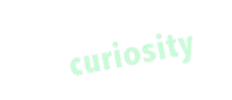


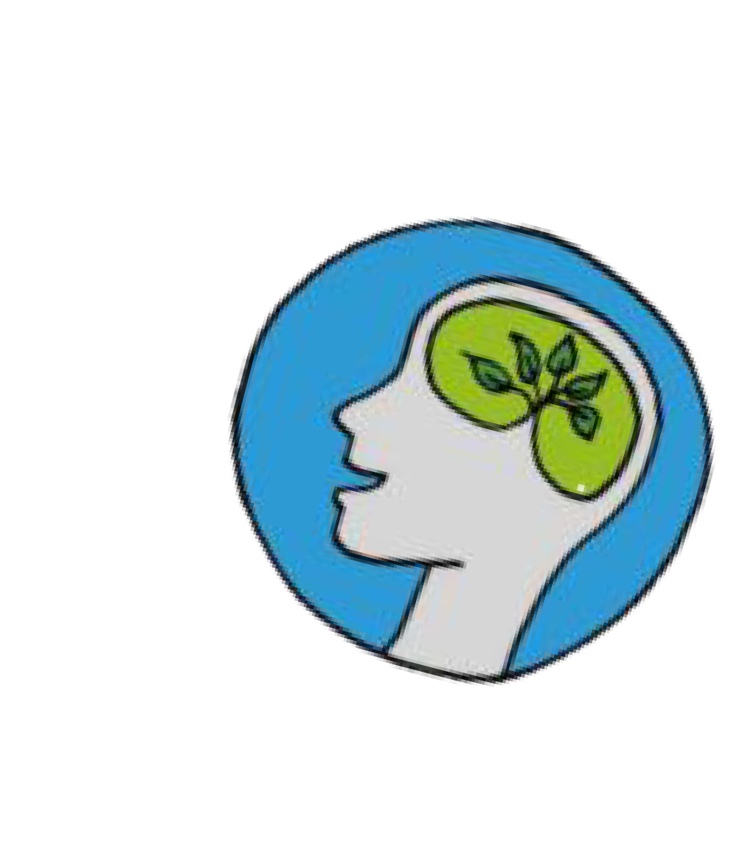
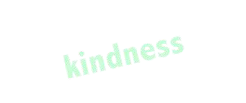
Frequency >> Intensity
Let go of forcing positivity in the moment.
Instead, maximize the likelihood of experiencing positive emotions on a
day-to-day basis by creating a mindset of positivity
THE SMALL STUFF MATTERS.
Jordyn Feingold, MAPP © Copyright 2020

Slide 84
E V A M P
R
84

Slide 85
Summary
We evolved and are cultured in our profession to over-value the negative (to use our red cape)
Helping our patients optimally requires helping ourselves and pursuing self-care!
Well-being = Relationships + Engagement + Vitality +
Accomplishment + Meaning + Positive emotions
  >> REVAMP!
It’s all about small shifts to getting us there!

Slide 86
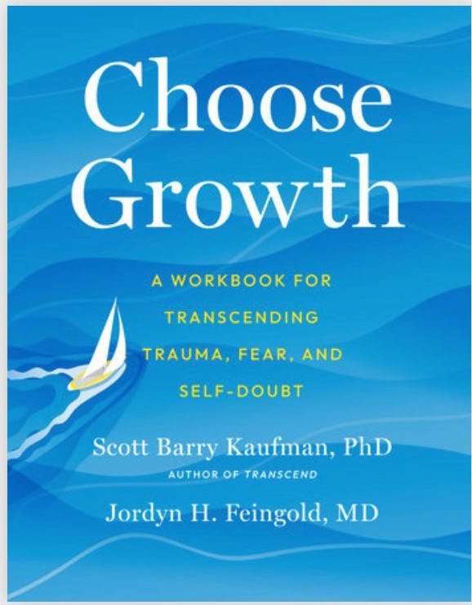
Looking for more?
If you want some self-directed learning….. check out:

Slide 87

Questions?

Slide 88



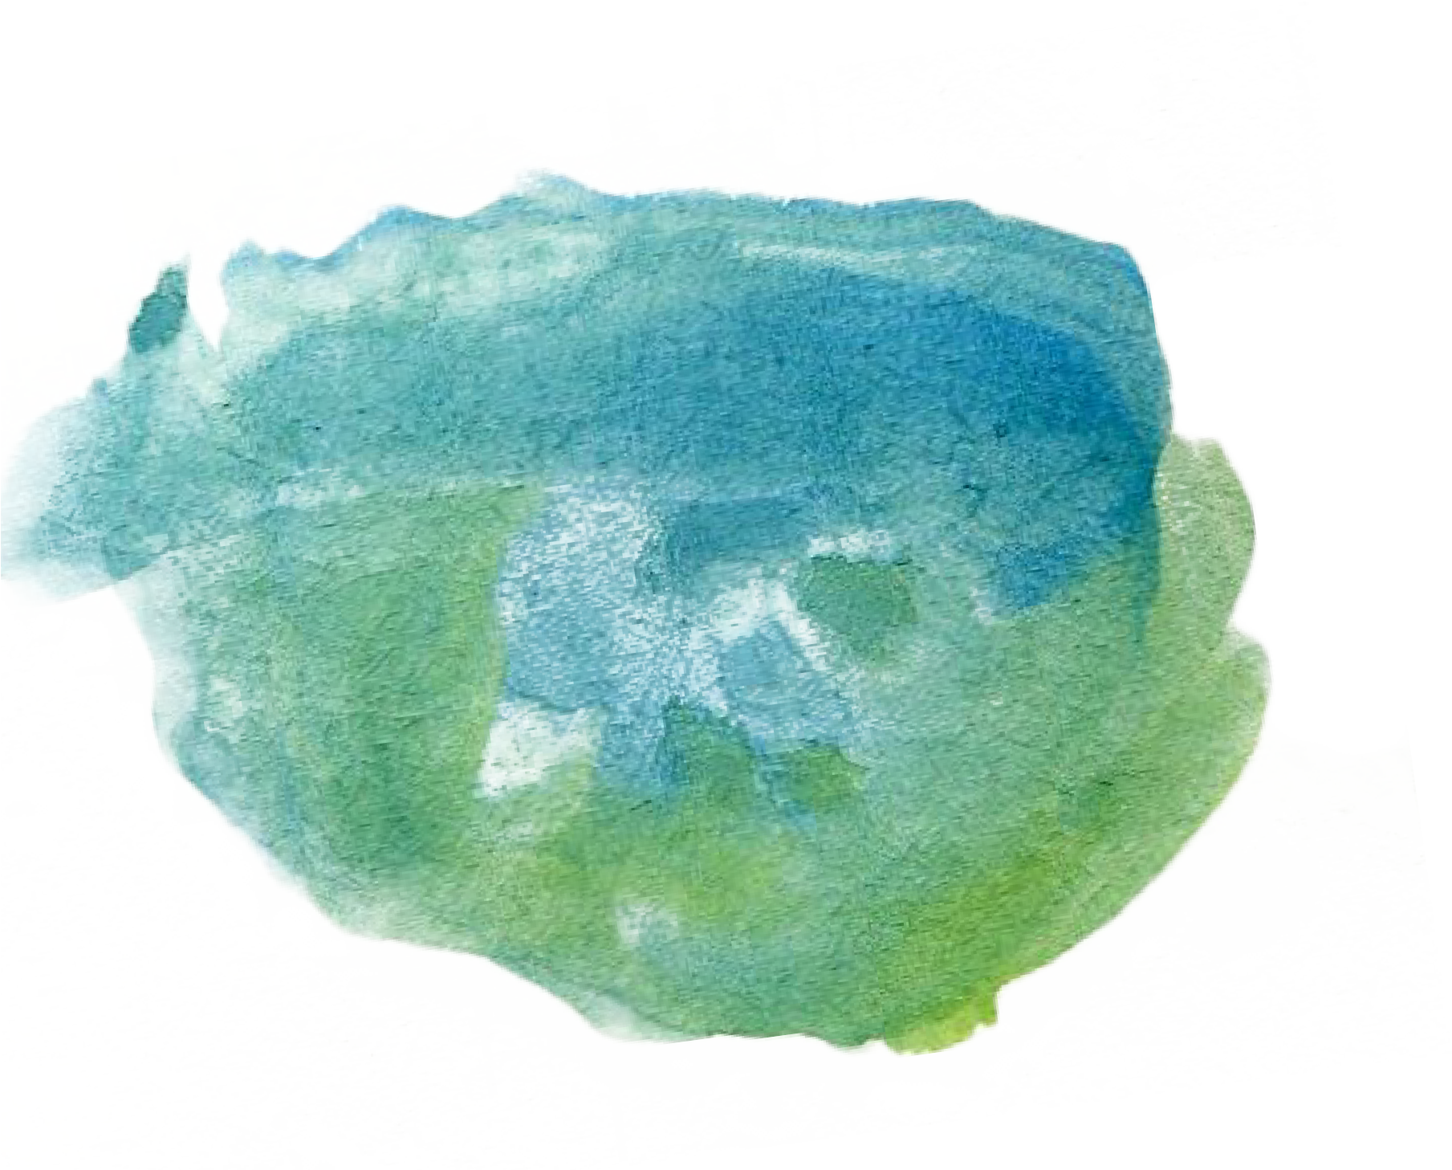
THANK YOU
Jordyn H. Feingold
MD, MSCR, MAPP
jordyn.feingold@gmail.com
www.positive-medicine.com jordynfeingold.norby.live

