Slide 1
Expanding the Scope of Adverse Childhood Experiences (ACEs): Implications for Service Delivery
Elinam Dellor, PhD, Assistant Professor
The Ohio State University, College of Social Work October 10th , 2023
2023 Annual Conference: The Ohio Council of Behavioral Health & Family Services Providers

Slide 2
Who is in the room?
2

Slide 3

Stress vs Trauma

Slide 4
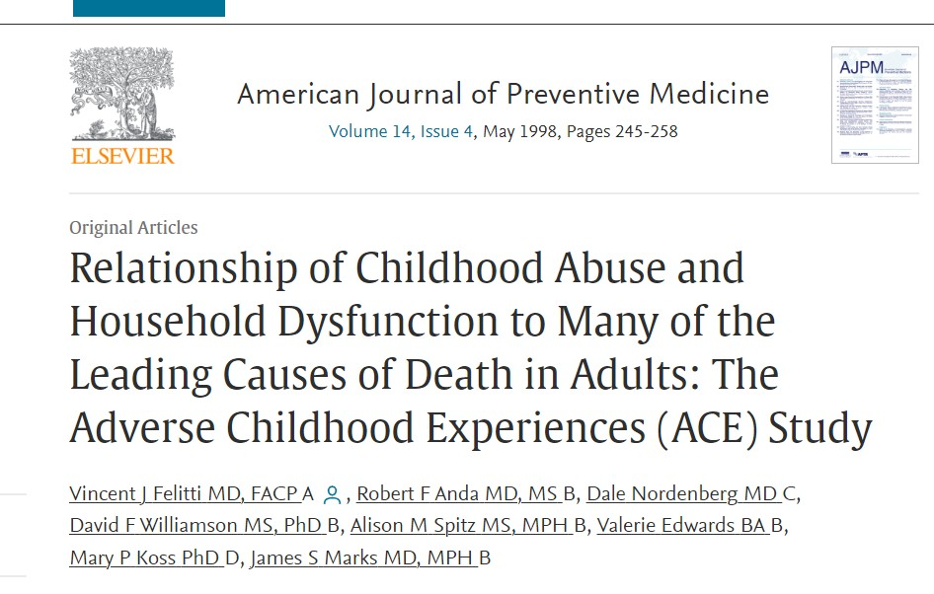
ACEs History/Background
Privately Insured Population
N= 17,000 Kaiser members
79% White
32% over age 65
43% college graduates or higher
4

Slide 5
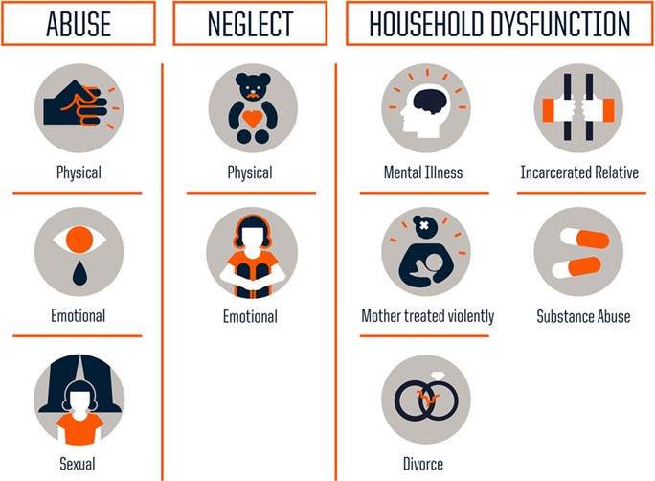
Measuring
Adverse Childhood Experiences
Figure: Robert Wood Johnson Foundation

Slide 6
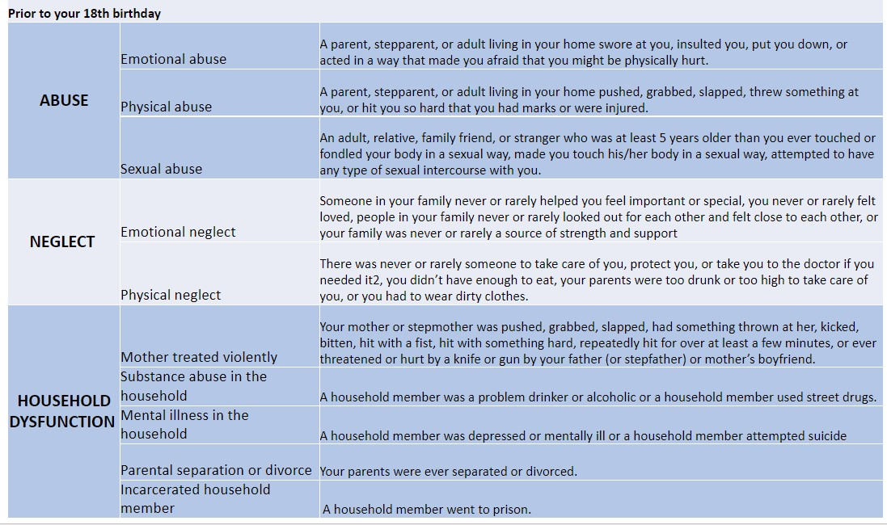
Original Study on (ACEs)

Slide 7
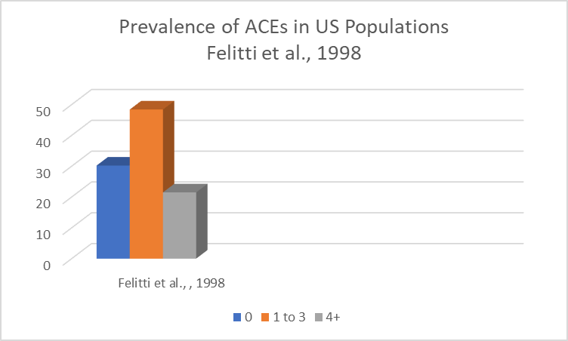
48.4%
30.1%
21.5%

Slide 8
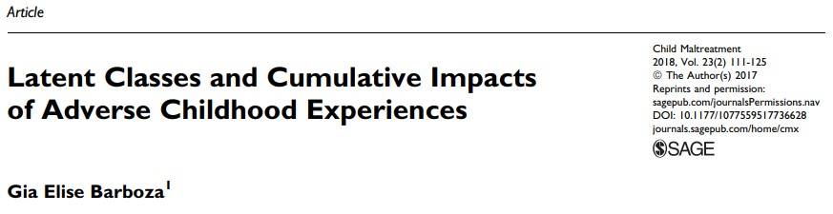


Childhood adversity is common.
Additionally, We Know That…

Slide 9
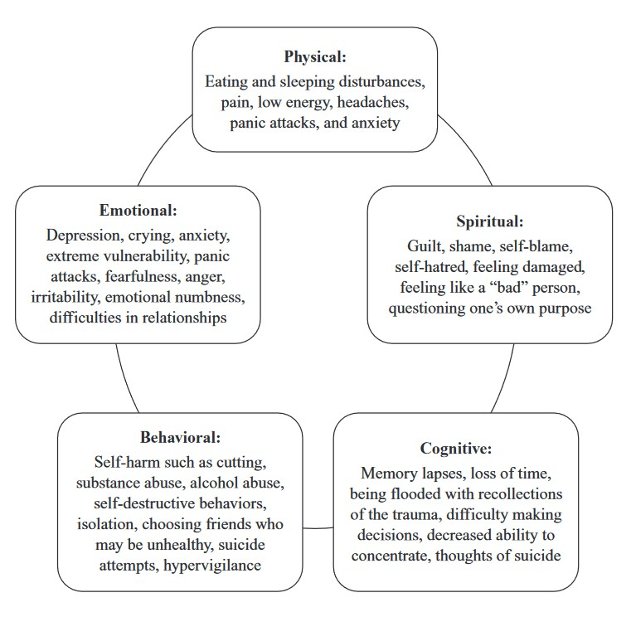
The Expression of Trauma
Marcellus, 2014

Slide 10


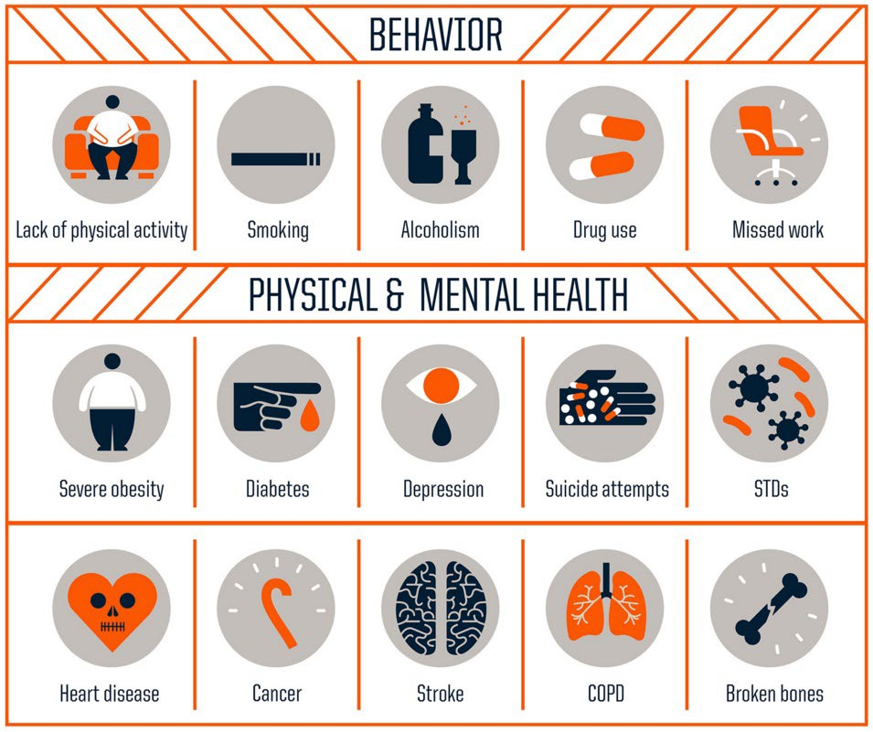
ACEs SCORE AND HEALTH RISK
As the ACE score increases, risk for these health problems increases in a strong and graded fashion:
Slide 10

Slide 11
Biopsychosocial Model
Traumatic Experiences
Health Outcomes
Child Abuse/Neglect
Physical Abuse
Sexual Abuse
Emotional Abuse
Neglect
Mental Health
Depression
Anxiety
Chronic Conditions
Household dysfunction
Cardiovascular diseases
Stroke
Diabetes
Household member depressed
Substance misuse
Incarcerated parent/caregiver
Violence between adults
Parental divorce/separation
Health Behaviors Smoking Drinking Diet Exercise
Mortality / morbidity
Time
11

Slide 12
Biopsychosocial Model
Traumatic Experiences
Health Outcomes
Child Abuse
Physical Abuse
Sexual Abuse
Emotional Abuse
Mental Health
Depression
Anxiety
Household dysfunction
Chronic Conditions
Household member depressed
Substance misuse
Incarcerated parent/caregiver
Violence between adults
Parental divorce/separation
Physiological Risks Nervous Endocrine
Cardiovascular diseases
Stroke
Diabetes
Health Behaviors Smoking Drinking Diet Exercise
Mortality / morbidity
Immune
Time
12

Slide 13
Biopsychosocial Model
Demographic Factors
Health Outcomes
Race
Ethnicity
Sex/Gender
Age
Child Abuse
Physical Abuse
Sexual Abuse
Emotional Abuse
Mental Health
Depression
Anxiety
Household dysfunction
Household member depressed
Substance misuse
Incarcerated parent/caregiver
Violence between adults
Parental divorce/separation
Chronic Conditions
Physiological Risks
Cardiovascul ar diseases
Stroke
Diabetes
Nervous Endocrine Immune Metabolic
Education Income Wealth Neighborhood s
Health Behaviors Smoking Drinking Diet Exercise
Mortality / morbidity

Slide 14
Biopsychosocial Model
Demographic Factors
Health Outcomes
Race
Ethnicity
Sex/Gender
Age
Child Abuse
Physical Abuse
Sexual Abuse
Emotional Abuse
Mental Health
Depression
Anxiety
Household dysfunction
Household member depressed
Substance misuse
Incarcerated parent/caregiver
Violence between adults
Parental divorce/separation
Chronic Conditions
Physiological Risks
Cardiovascul ar diseases
Stroke
Diabetes
Nervous Endocrine Immune Metabolic
Education Income Wealth Neighborhoo ds
Health Behaviors Smoking Drinking Diet Exercise
Mortality / morbidity

Slide 15
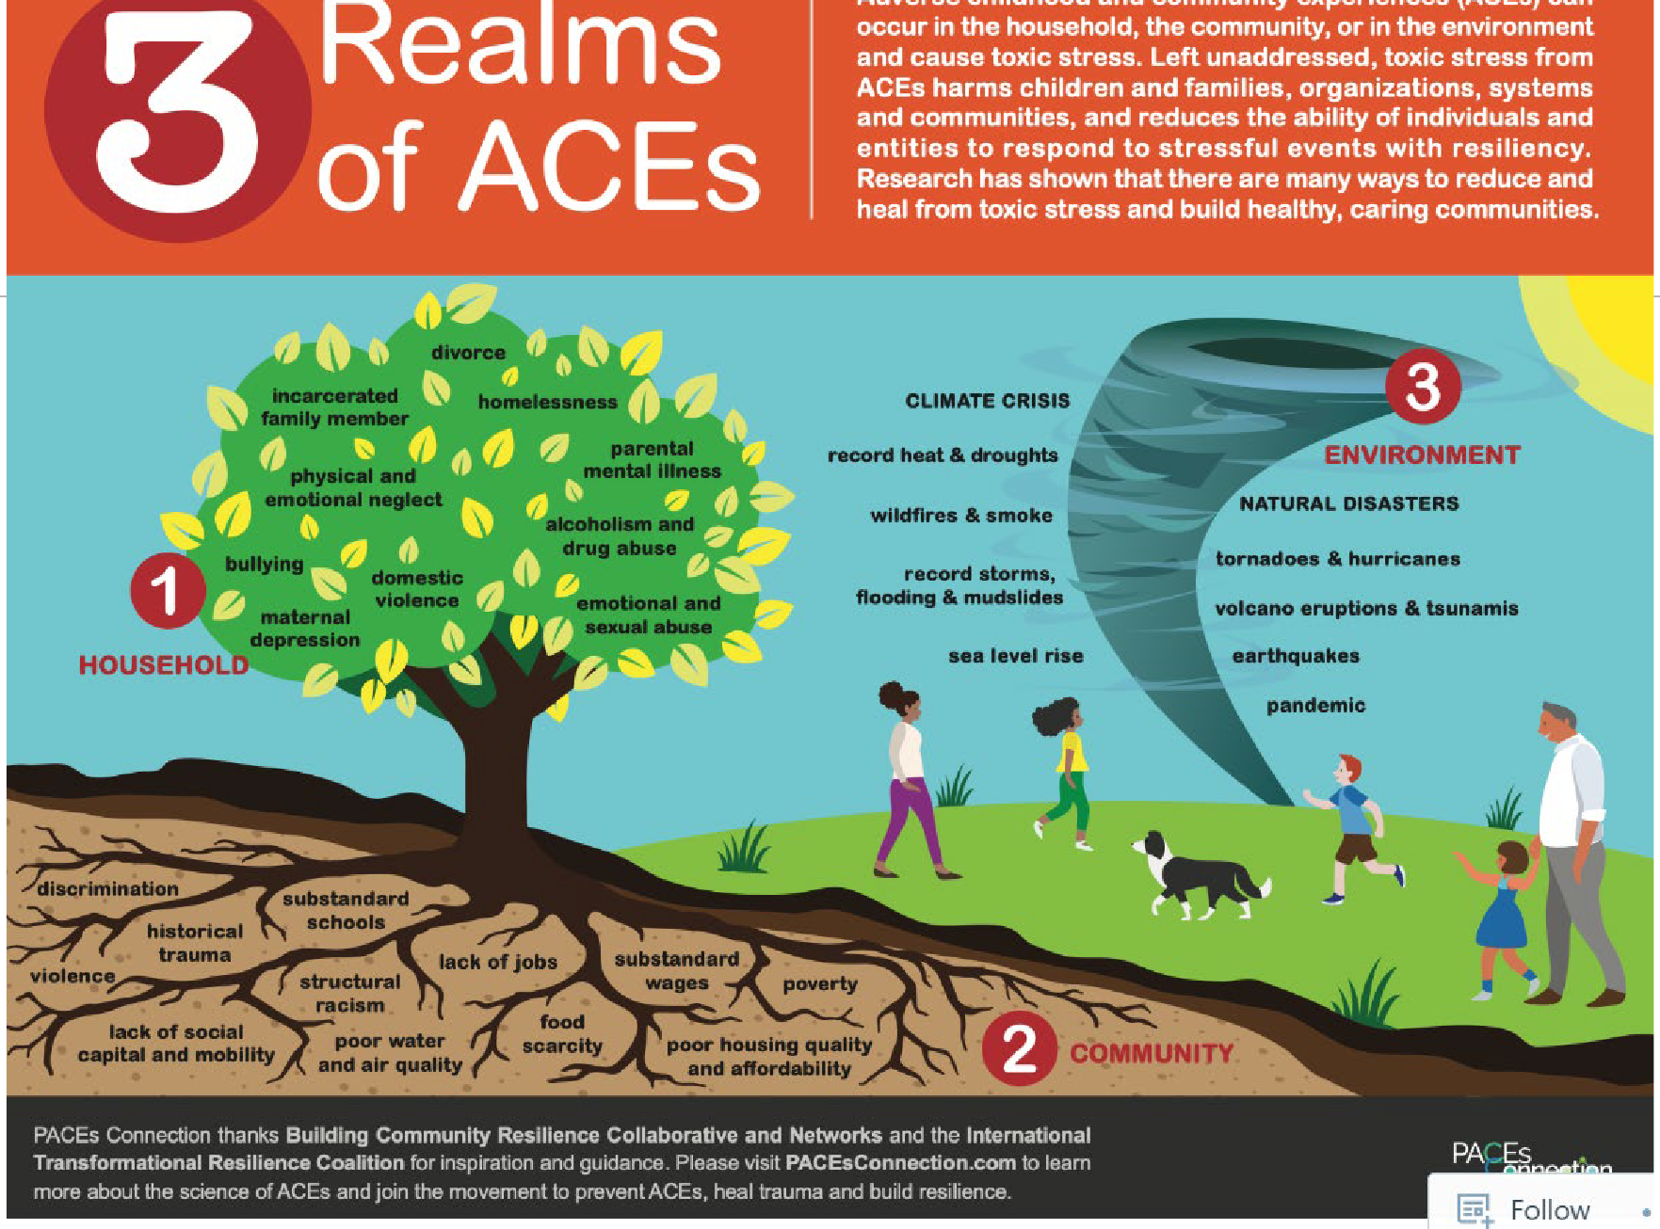
Resources – ACEs Too High
15

Slide 16
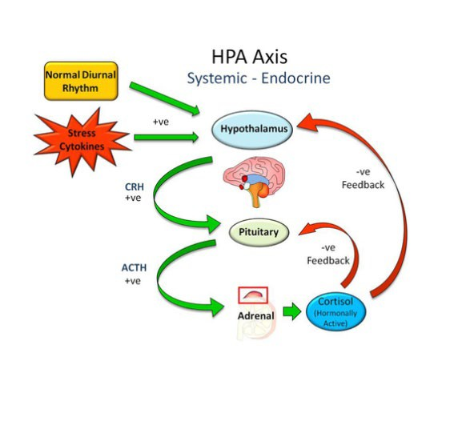
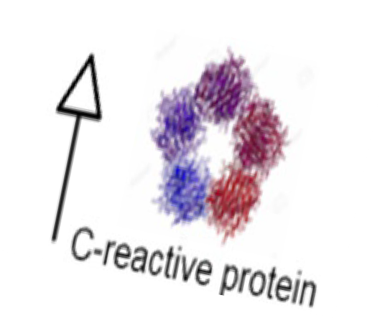

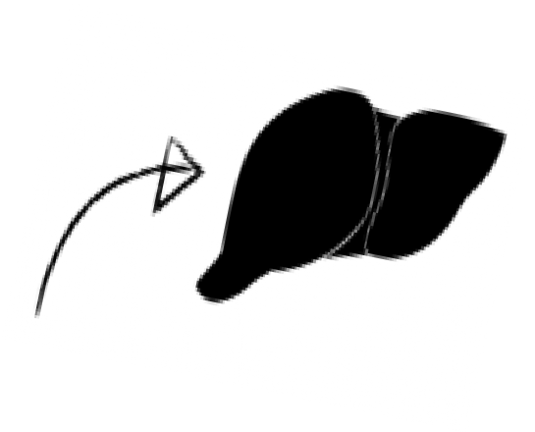
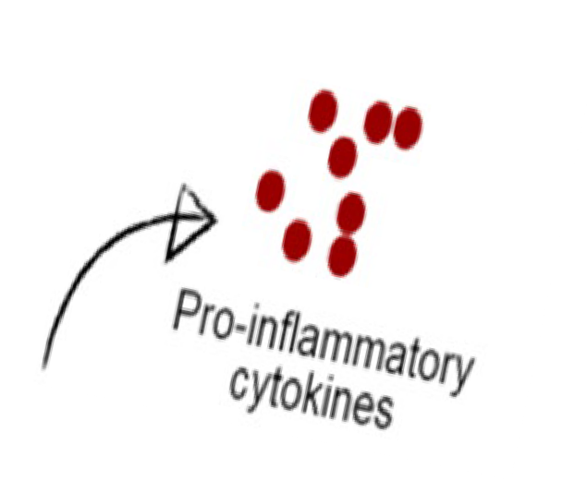
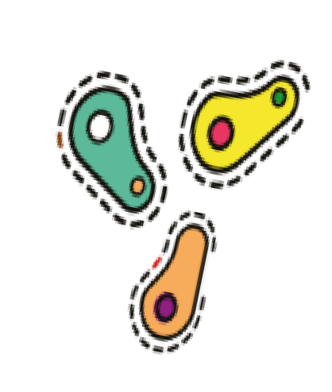

Nervous
Immune
Endocrine

Slide 17
Commonly Studied Biological Markers
PULSE PRESSURE HEART RATE
CORTISOL (SALIVA, BLOOD, HAIR)
HEMOGLOBIN A1C ( HBA1C)
HIGH-DENSITY LIPOPROTEIN ( HDL) CHOLESTEROL
TOTAL CHOLESTEROL
C-REACTIVE PROTEIN (CRP)
INFLAMMATORY CYTOKINES ( TNF-ALPHA; INTERLEUKINS)
WAIST CIRCUMFERENCE

Slide 18
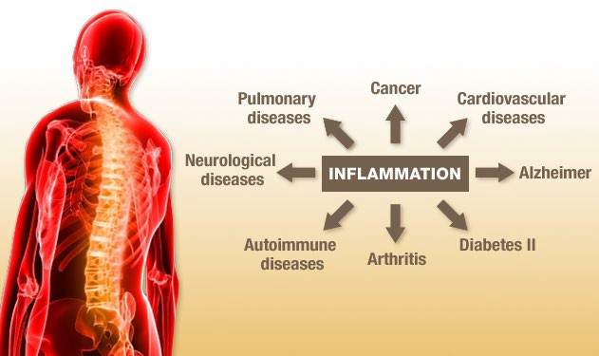
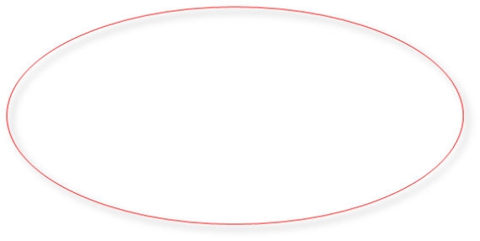
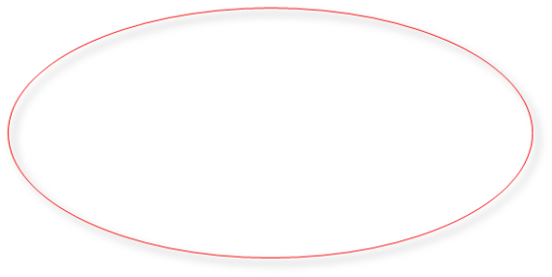
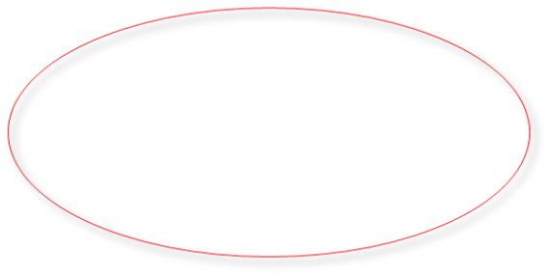
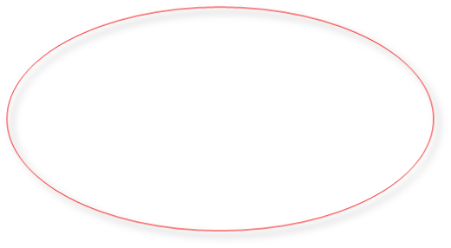

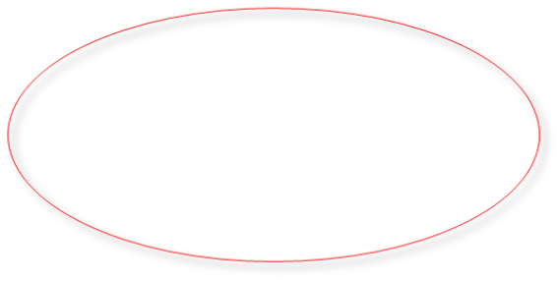

Slide 19
ACEs in Special Populations
19

Slide 20
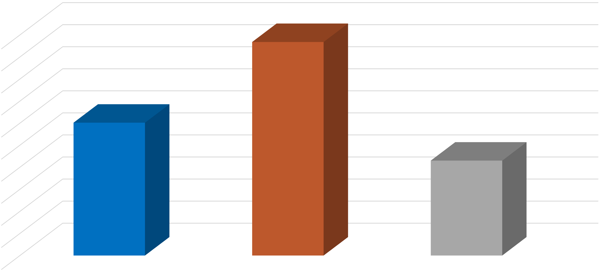
Distribution of ACEs, Felitti, 1998
48.4%
50.00%
45.00%
30.1%
40.00%
35.00%
21.5%
30.00%
25.00%
20.00%
15.00%
10.00%
5.00%
0.00%
0
1 to 3
4+

Slide 21
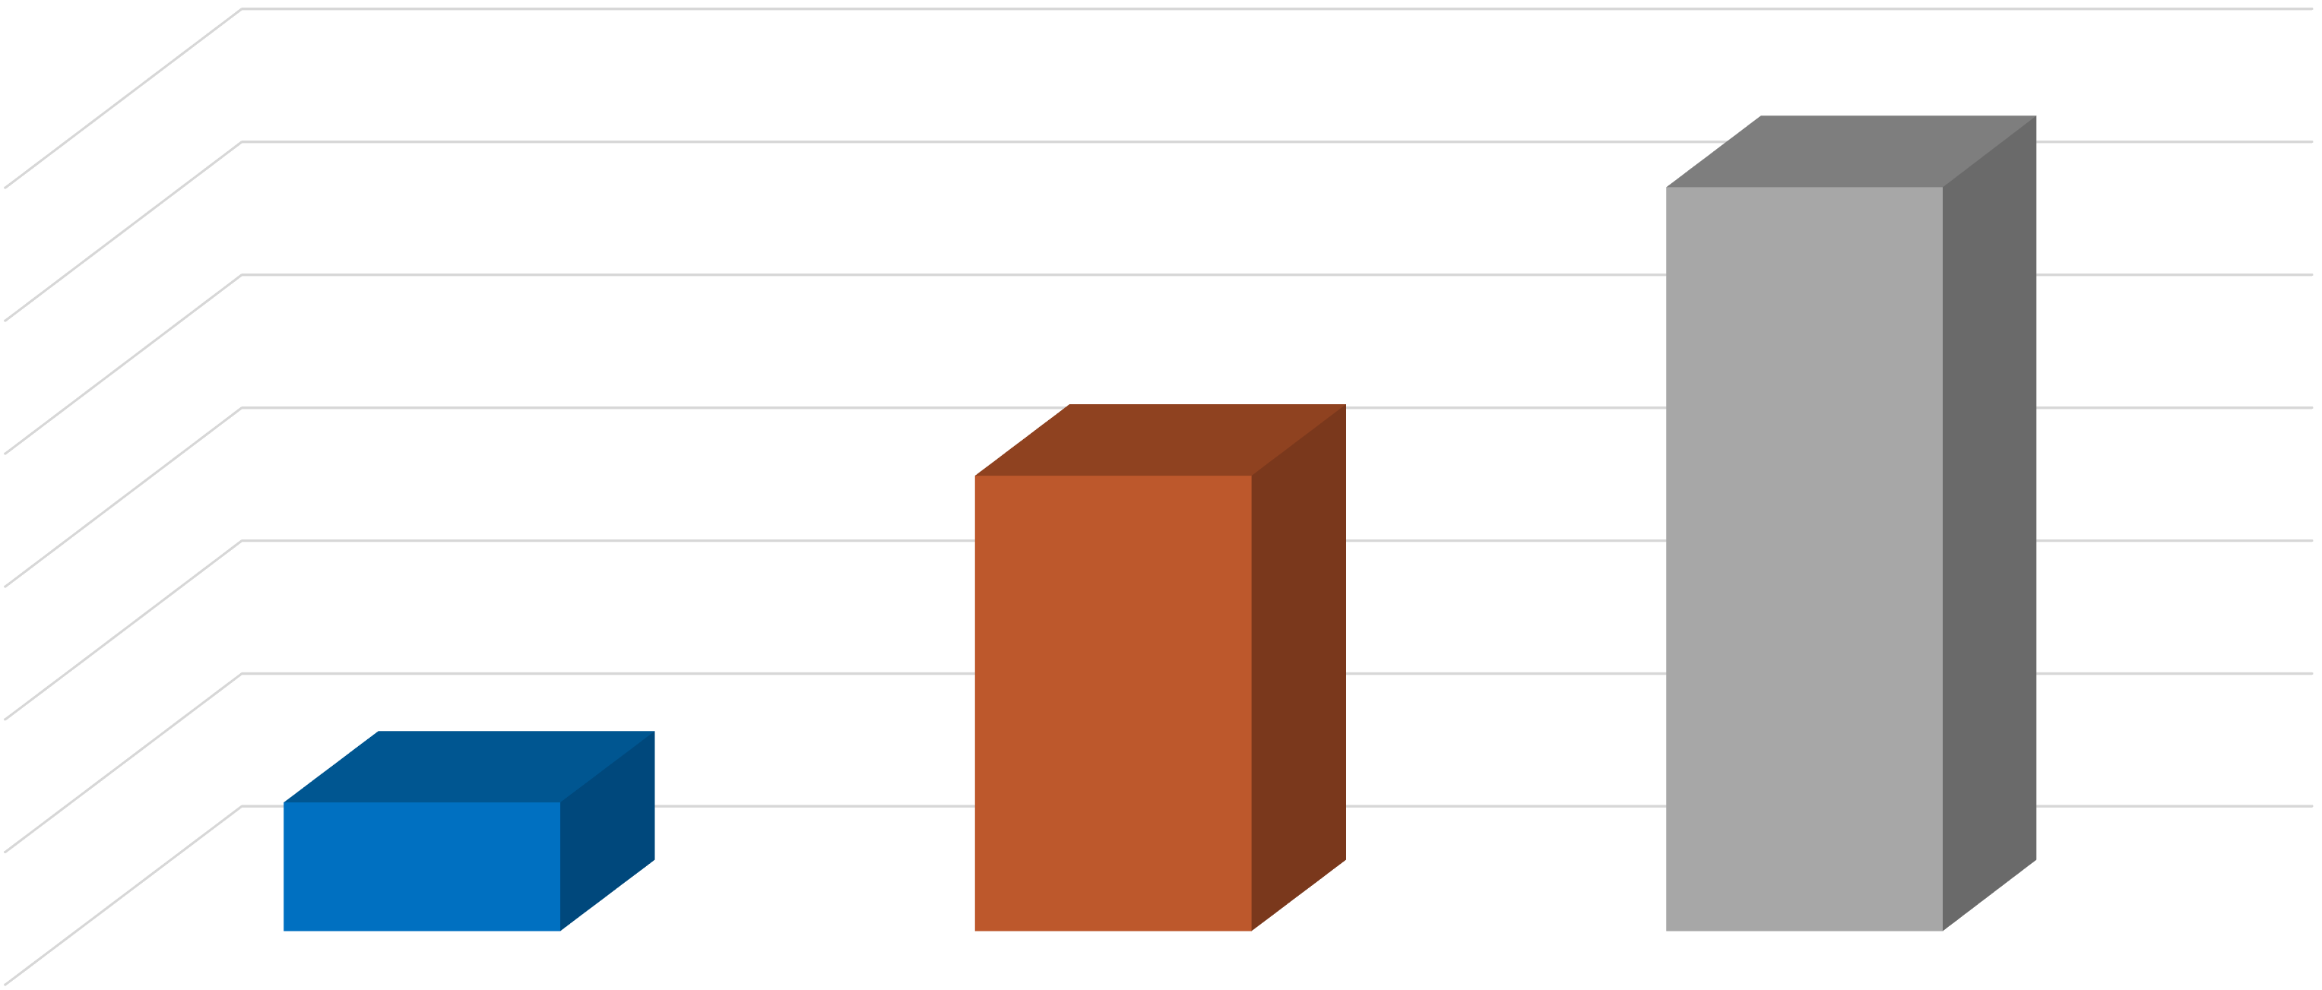
Distribution of ACEs Among Child Welfare Involved Families. Dellor et al. 2022
56.0%
60.00%
34.3%
50.00%
40.00%
30.00%
9..7%
20.00%
10.00%
0.00%

Slide 22
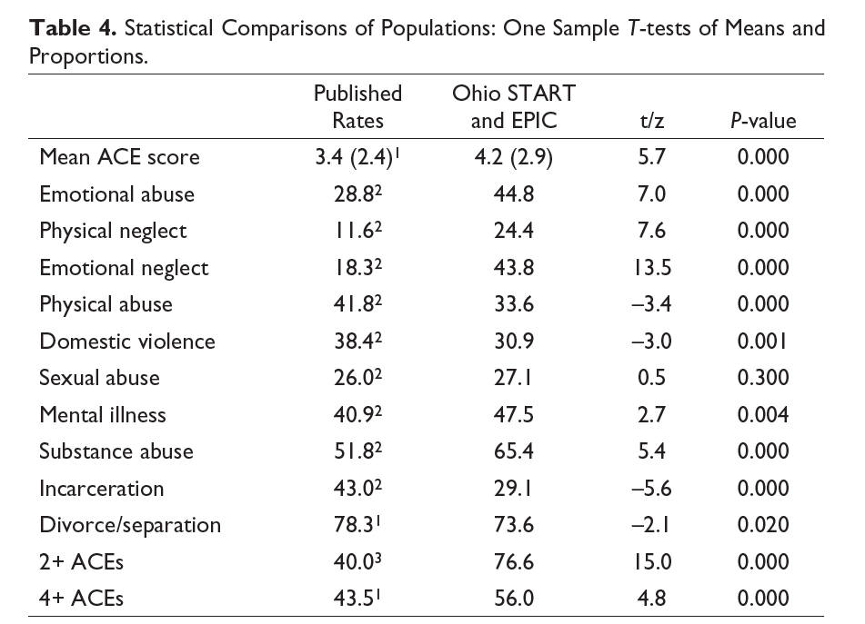

Slide 23
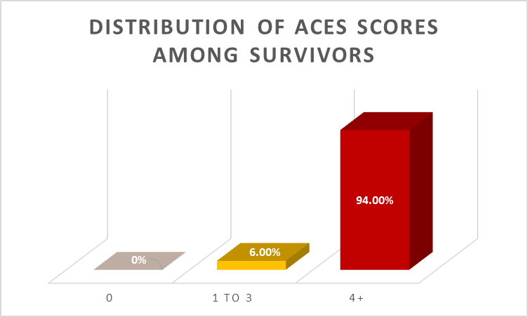
23

Slide 24
ACEs |  | Item | % | N
 |  | Emotional Abuse | 88% | 44
 | Abuse | Physical Abuse | 72% | 36
Prevalence by Category |  | Sexual Abuse | 88% | 44
 |  | Emotional Neglect | 78% | 39
 | Neglect
 |  | Physical Neglect | 54% | 27
 |  | Separation / Divorce | 86% | 43
 |  | Intimate Partner Violence | 74% | 37
 | Household Dysfunction | Problem Drinking / Substance Use in the Home | 82% | 41
 |  | Mother with Mental Illness | 78% | 39
 |  | Parental Incarceration | 42% | 21
24

Slide 25
Missing ACEs?
School & community violence
Disasters & accidents
Invasive or prolonged medical procedures
Discrimination, Racism & Oppression
Poverty
Trafficking
Homelessness
Foster Care Involvement
Loss
Bullying
Migration / immigration

Slide 26
Culturally and Ethically-Informed Measures
26

Slide 27
The Philadelphia ACEs Survey (2012-13)
N= 1,784
Age 18+, Southeastern Pennsylvania
Random-digit dialing
Cronholm et al., 2015

Slide 28
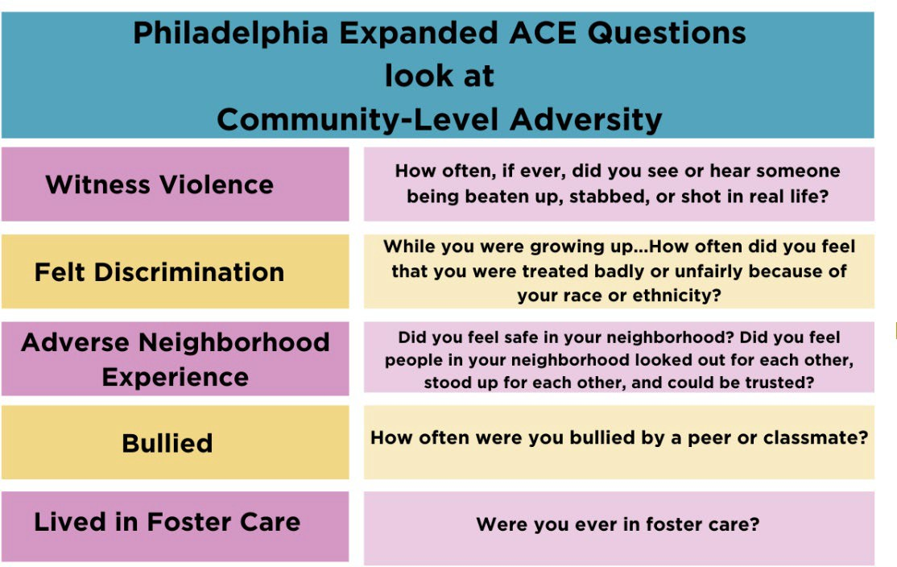
The Philadelphia ACEs Survey (2012-13)
Cronholm et al., 2015

Slide 29
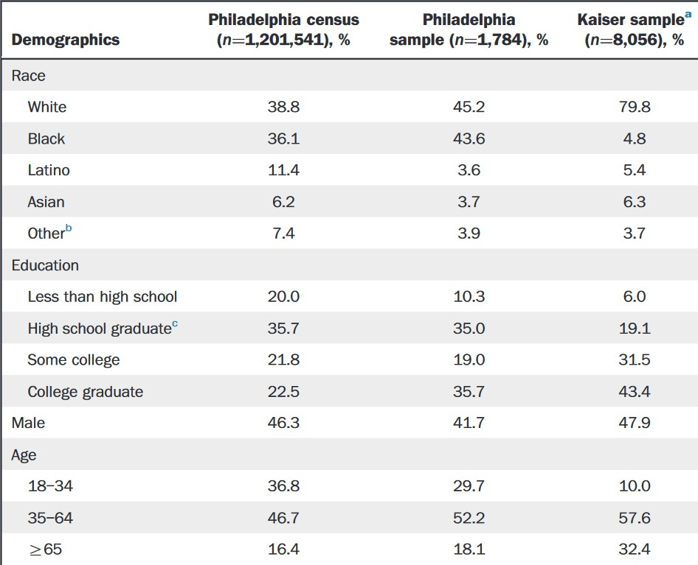
The Philadelphia ACEs Survey (2012-13)
Cronholm et al., 2015
29

Slide 30
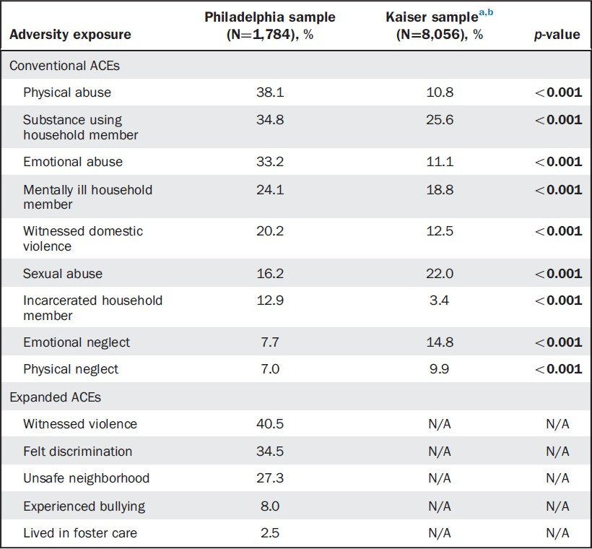
The Philadelphia ACEs Survey (2012-13)
Cronholm et al., 2015
30

Slide 31
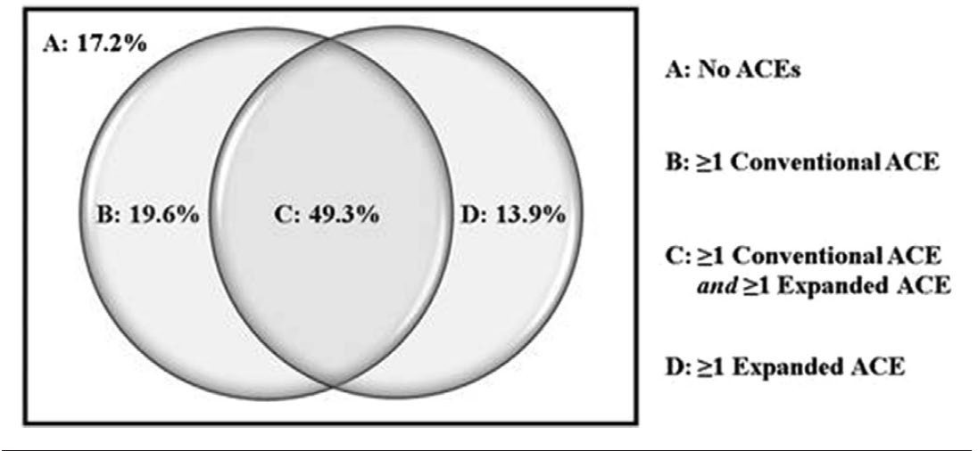
The Philadelphia ACEs Survey (2012-13)
Cronholm et al., 2015
31

Slide 32
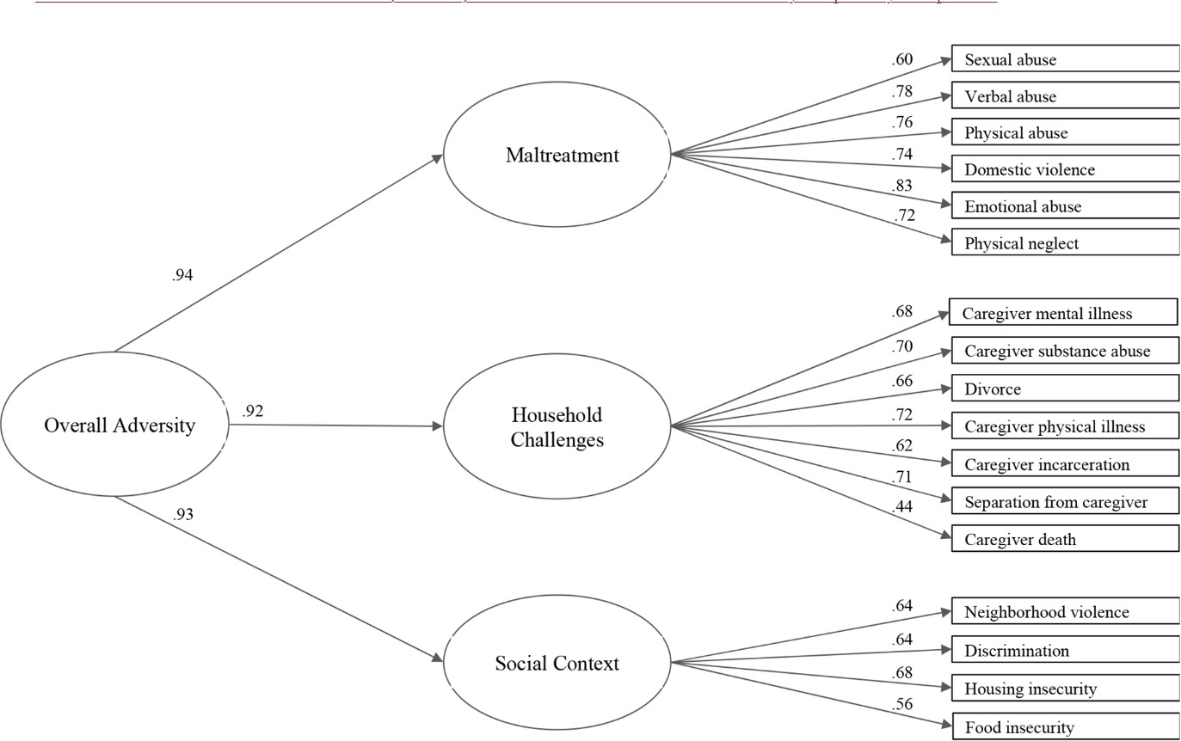
Pediatric ACEs and Related Life Events Screener (PEARLS)
Ye et al., 2023
32

Slide 33
Pediatric ACEs and Related Life Events Screener (PEARLS)
N= 340
Age 18+, San Francisco, CA
Not in foster care
English and/or Spanish speaking
Ye et al., 2023

Slide 34
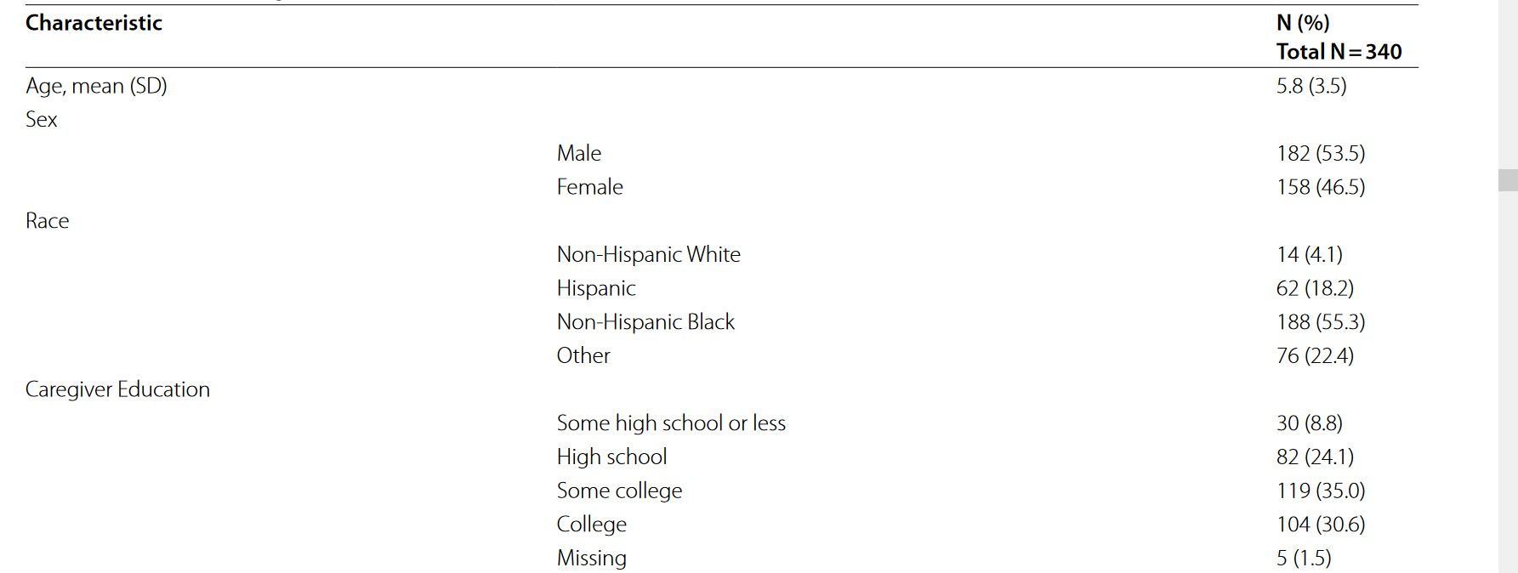
Ye et al., 2023

Slide 35
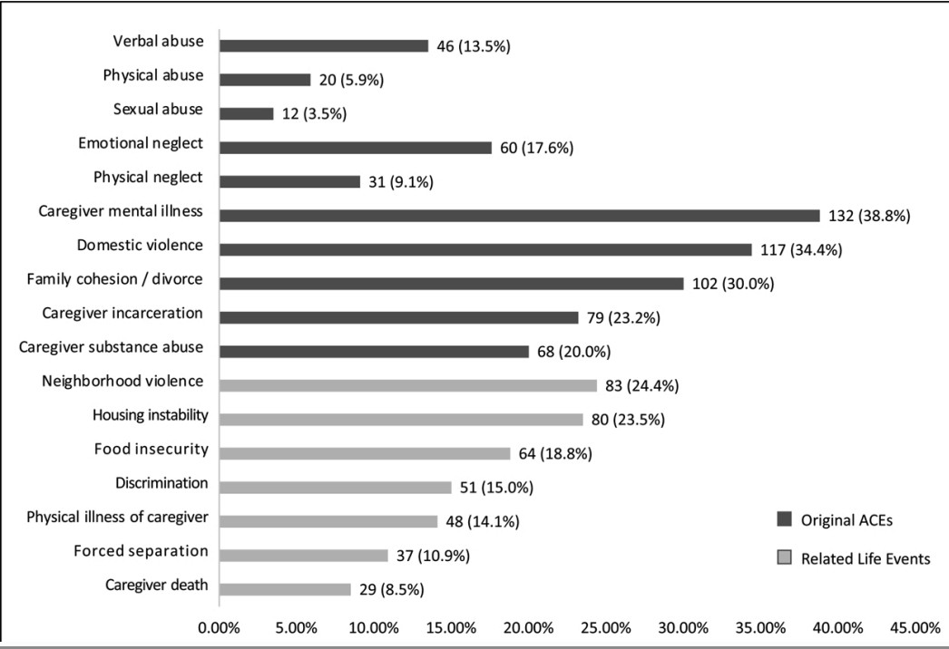
PEARLS Results
Ye et al., 2023

Slide 36
Perceptions of Racism in Children and Youth (PRaCY)
Specific to children
N=277 children
Ages of 8 and 18 years
Latinx | 38%
African America | 31%
Multiracial | 19%
West Indian/ Caribbean | 7%
Other | 5%
Pachter et al., 2010

Slide 37
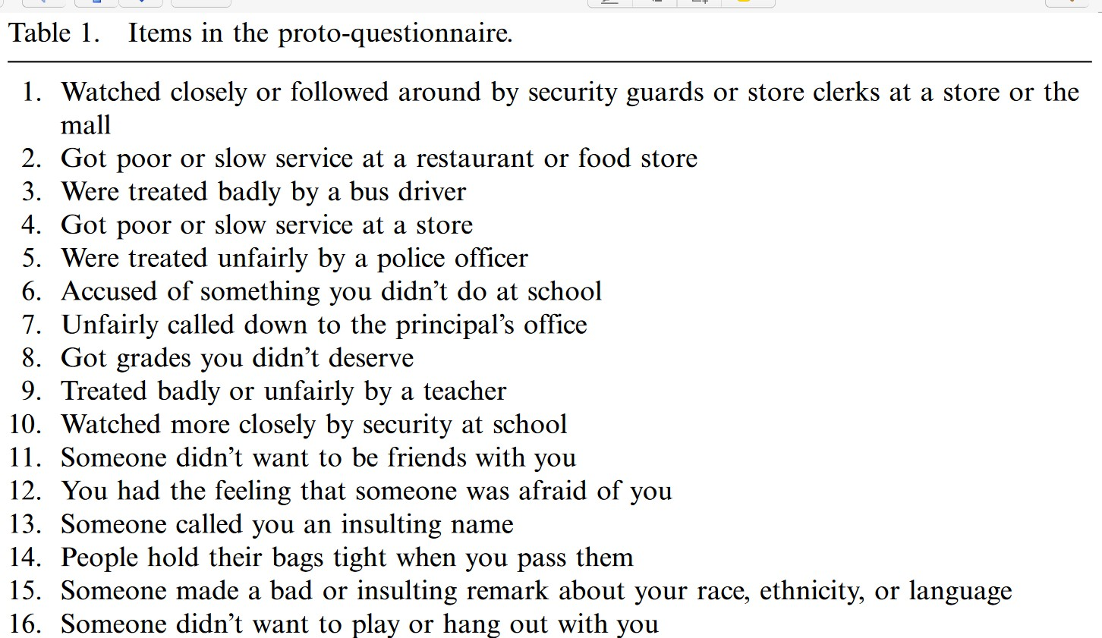
Perceptions of Racism in Children and Youth (PRaCY)
Pachter et al., 2010

Slide 38
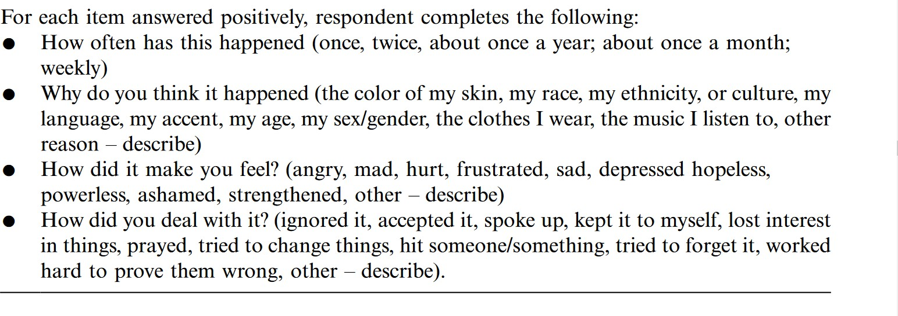
Perceptions of Racism in Children and Youth (PRaCY)

Slide 39
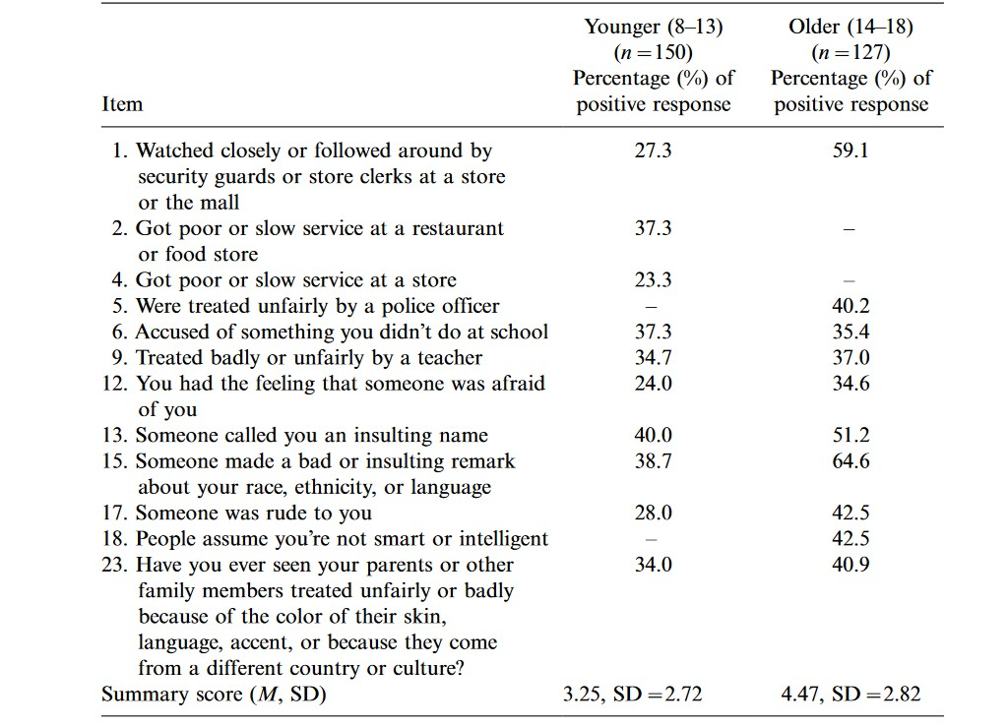

Slide 40
NAME | DOMAINS
The Center for Youth Wellness - ACE-Q(CYW ACE-Q) | Foster care, bullying, community violence, discrimination, IPV
Adverse Childhood Experiences International Questionnaire (ACEs-IQ) | Peer and community violence; collective violence.
Cultural and Ethnic Experiences Scale (CEES) | Cultural and ethnic discrimination, acculturation stress, and cultural identity conflict.
Multigroup Ethnic Identity Measure (MEIM) | Ethnic identity exploration, resolution, and affirmation.
Racial and Ethnic Microaggressions Scale (REMS) | Microaggressions and subtle forms of racism experienced by individuals of color, including African Americans.
Hispanic Stress Inventory - Adolescent Version (HSI-A) | Acculturative stress, experiences of discrimination, and family and environmental stressors among Hispanic adolescents.

Slide 41
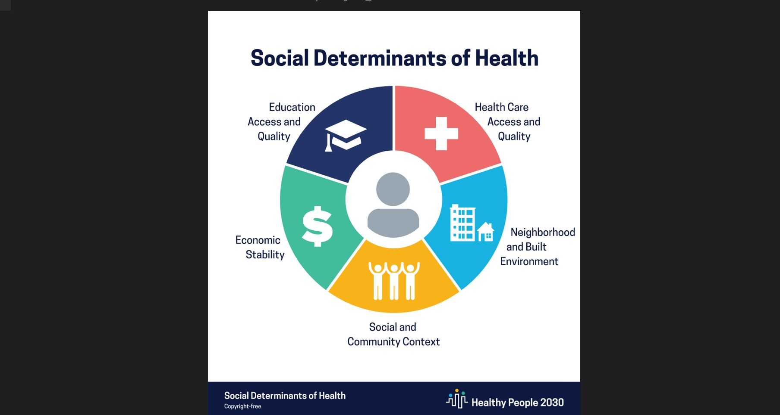

Slide 42
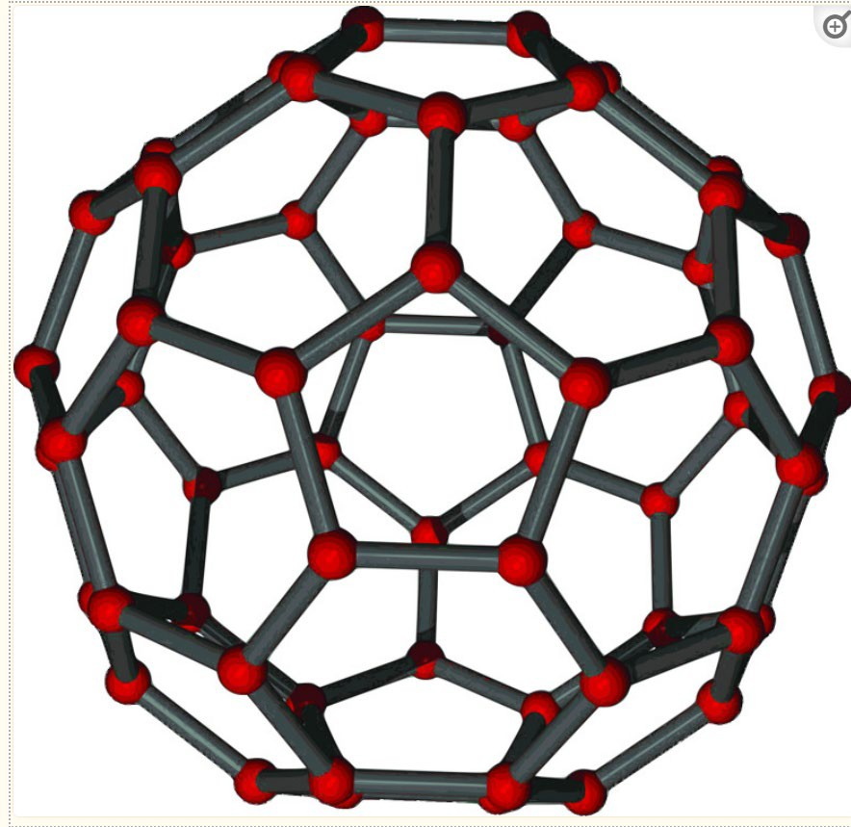
Structural racism
Gee & Hickens, 2021

Slide 43
“If a neighborhood is to retain stability it is necessary that properties shall continue to be occupied by the same social and racial classes”
Home Owners’ Loan Corporation (HOLC), 1933
In Central Ohio:
2/3 of subdivisions has restrictive covenants place in them.
Federal and local governments
Financial/bank systems
Highway systems

Slide 44
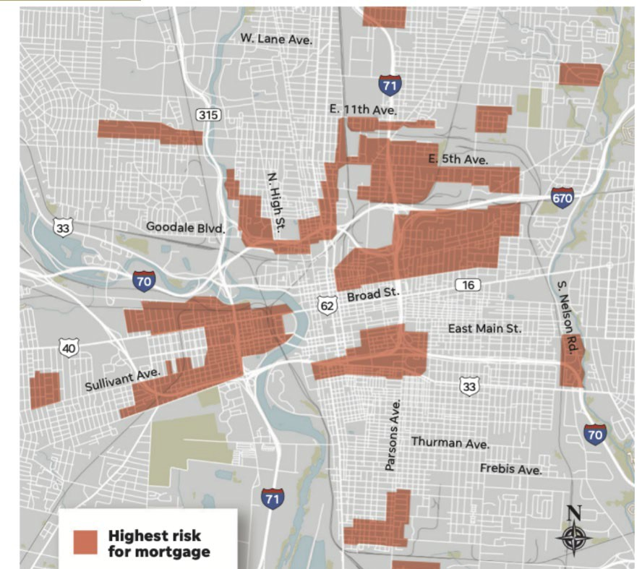
NCRC, 2020

Slide 45
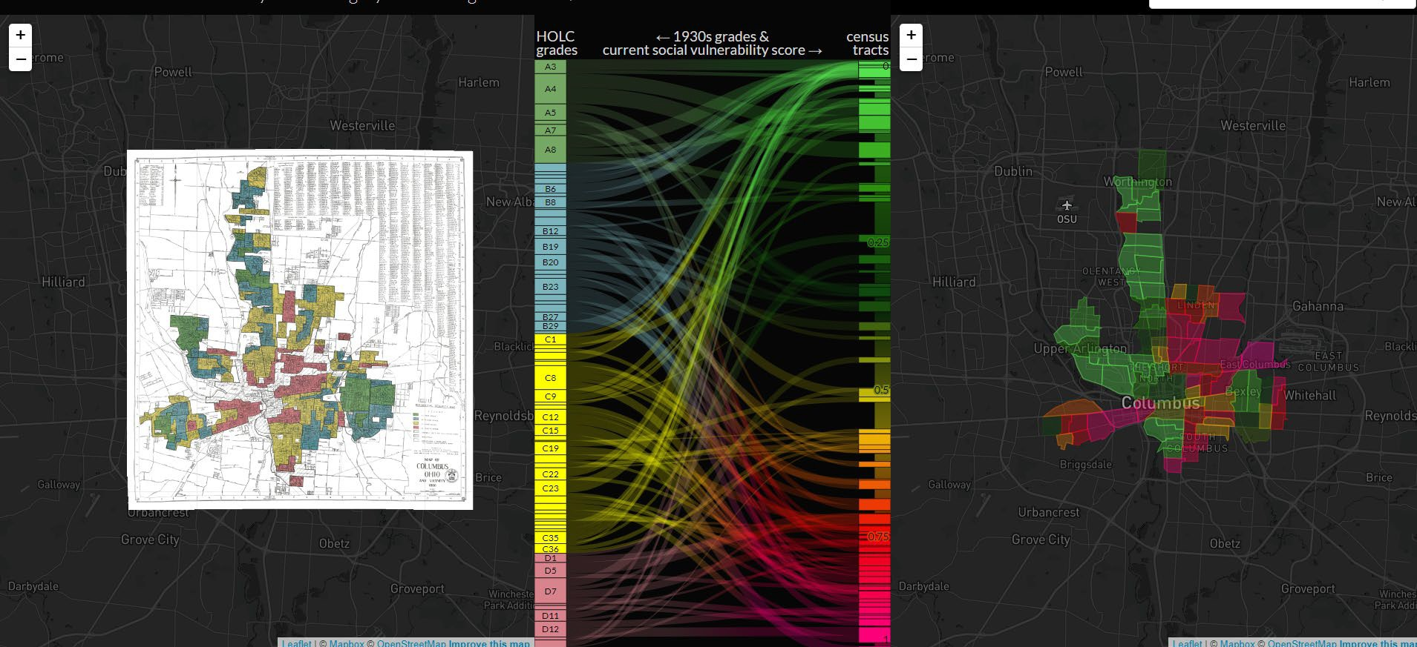

Slide 46
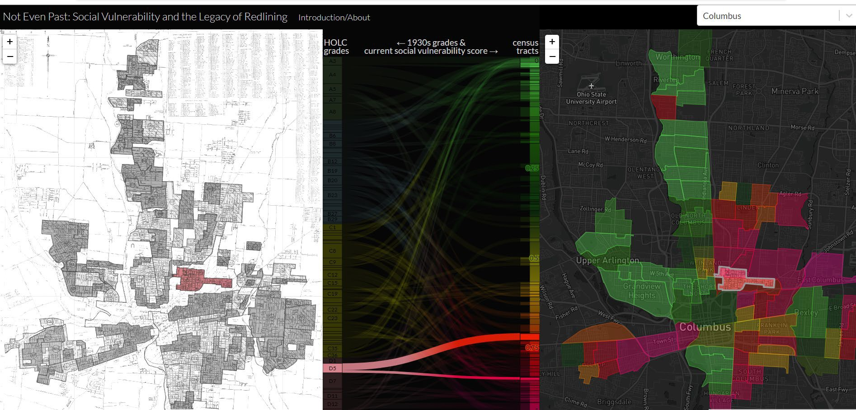

Slide 47
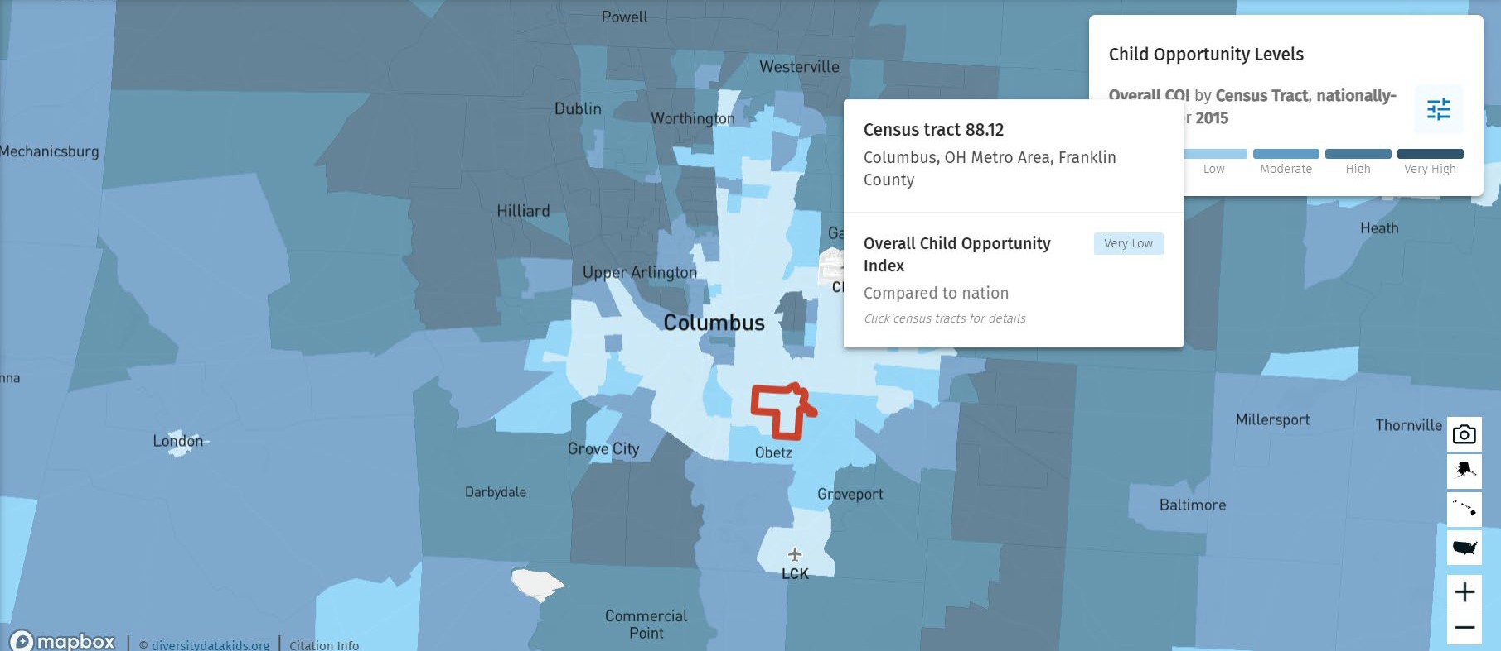
Child Opportunity Index (COI)
47

Slide 48
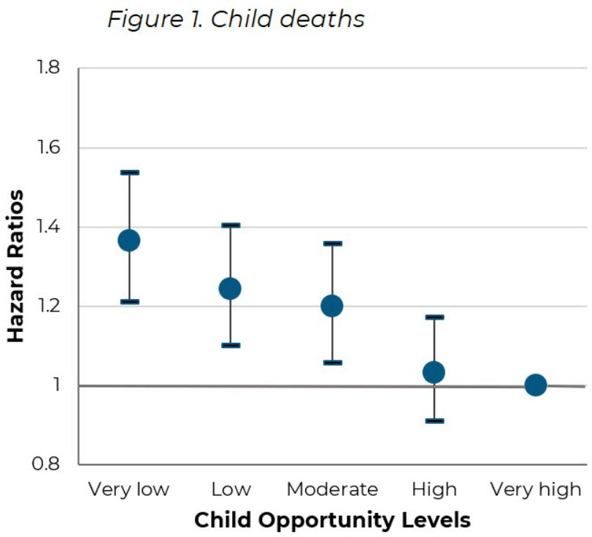
Neighborhood Opportunity and Mortality Among Children and Adults,
Slopen et al., 2023
48

Slide 49
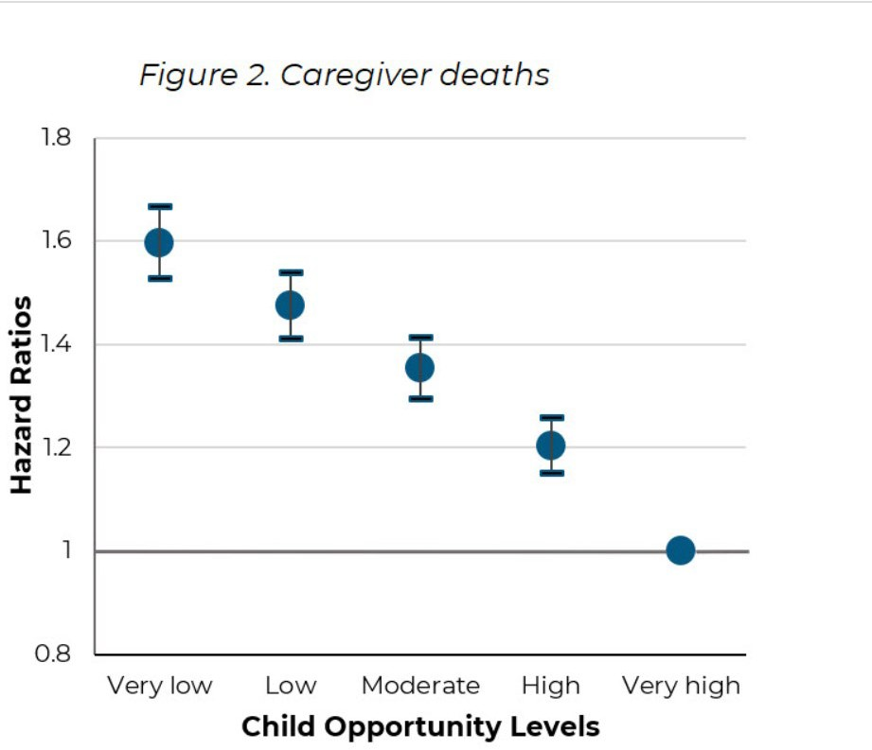
Neighborhood Opportunity and Mortality Among Children and Adults,
Slopen et al., 2023
49

Slide 50
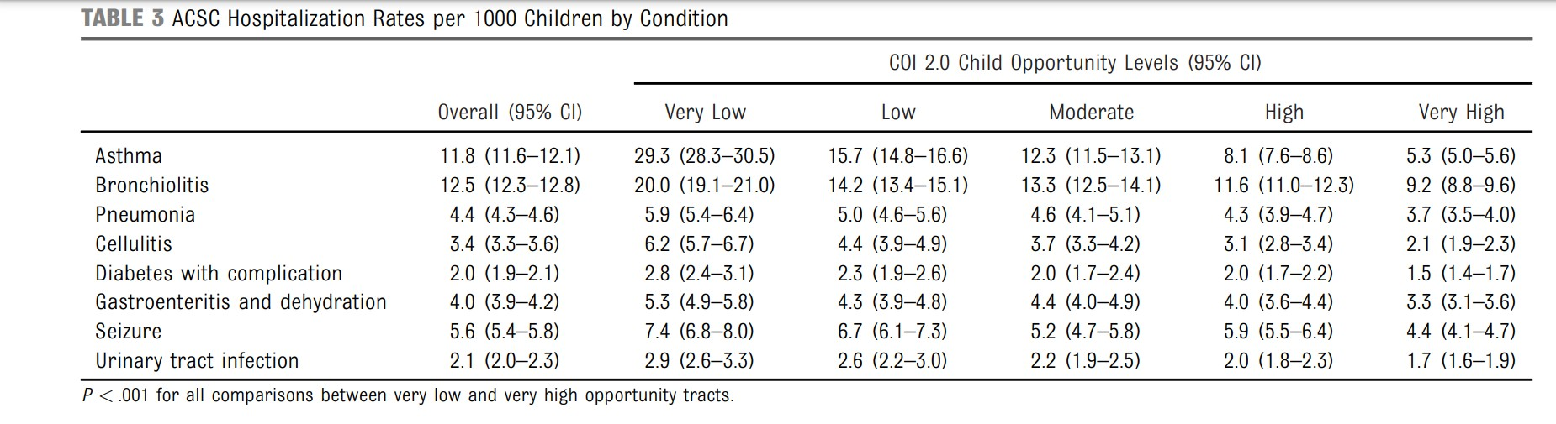
50

Slide 51

Toward trauma-informed
service systems
51

Slide 52
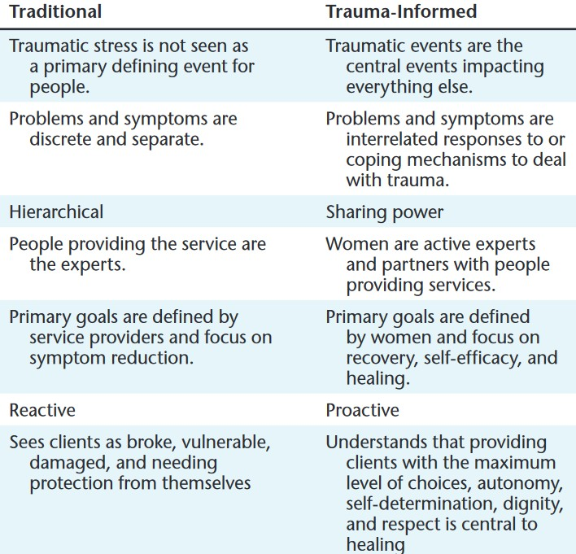
52

Slide 53
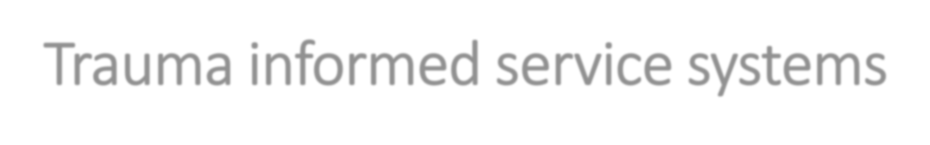
Trauma informed service systems
Routinely screen for trauma exposure and related symptoms
Use culturally appropriate evidence-based assessment and treatment
Make resources available
Engage in efforts to strengthen the resilience and protective factors of children and families

Slide 54
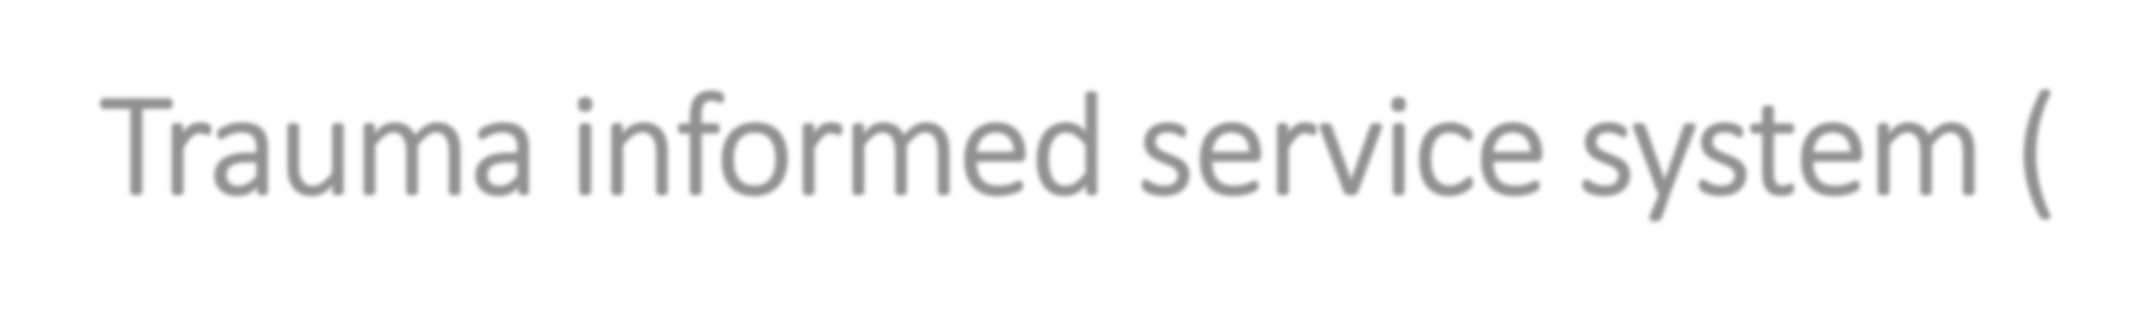


Trauma informed service system (cont)
Address parent and caregiver trauma and its impact on the family system
Emphasize continuity of care and collaboration across child-service systems
Maintain an environment of care for staff

Slide 55
Barriers to routine screening
Valid, age-appropriate assessment tools?
Appropriate for clients?
Appropriate for setting?
Time?
$$?
55

Slide 56

Screening as a process
Provides information to meet the family where they are
Provides information about the adults and children to share with others
Creates connection between trauma and functioning
Threshold for the need for further assessment/monitoring
56

Slide 57
Table 4. Weighted Distribution of Mean CRP by CSA Reporting Patterns Wave III-Wave IV (Add Health 1994-2008, N=9,268)
M | ean CRP (SD)ª
Pattern of CSA Reporting
Consistent Non-reporters (No to No) | 2.60 (2.50)**
Consistent Reporters (Yes to Yes) | 3.00 (2.60)
Inconsistent Reporters (No to Yes) | 2.75 (2.30)
Inconsistent Reporters (Yes to No) | 3.00 (2.60)
Note: Analyses Weighted a Wald test ** p≤0.01

Slide 58
Table 6. Weighted OLS Regression of Log CRP by CSA Reporting Patterns (Add Health 1994-2008, N=9,268)
 | Model 2^{b}
Pattern of CSA Reporting
Consistent Non-reporters (No to No) | - -
Consistent Reporters (Yes to No) | 0.06 (0.13)
Inconsistent Reporters (No to Yes) | 0.11 (0.08)
Inconsistent Reporters (Yes to No) | 0.16 (0.08) *
2 R =0.04 Note: Analysis weighted: * p≤0.05 b Adjusts for young adult and childhood socio-demographic characteristics

Slide 59
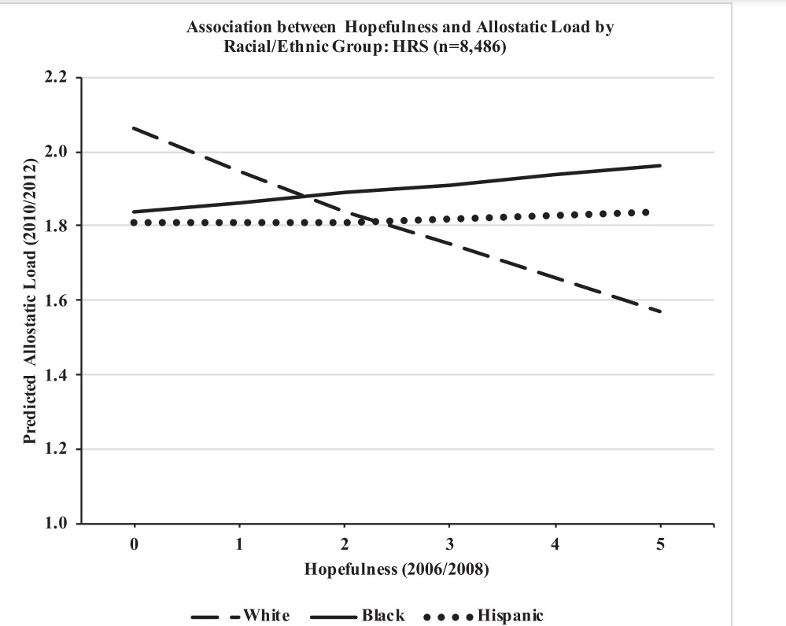


Slide 60
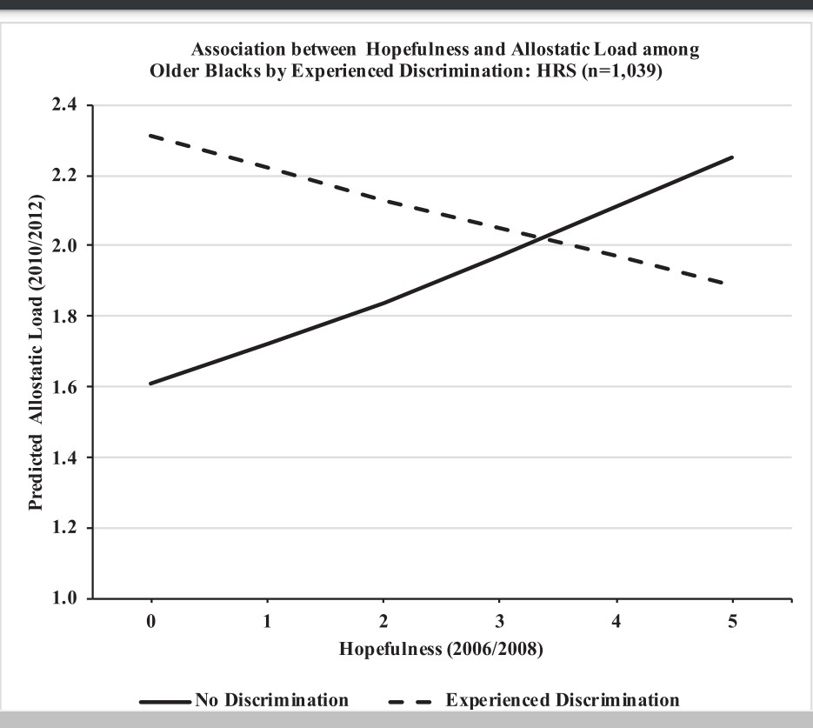

Slide 61
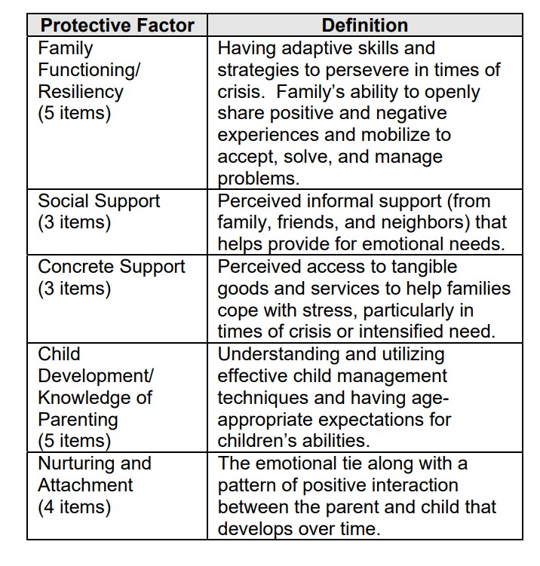
Protective Factors Survey

Slide 62
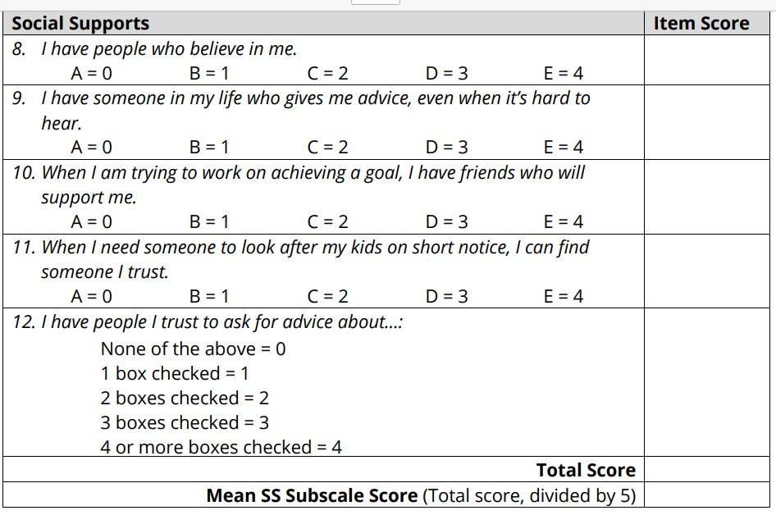
Protective Factors Survey

Slide 63
FAMILY
Being able to talk openly to a family member or as a family about feelings and feel heard, accepted and supported.
Belief that family stood by them during difficult times.
Feeling safe and protected by an adult in the home
Positive Childhood Experiences (PCE)
PEERS/COMMUNITY
Feeling supported by friends.
Having a sense of belonging and connection with a larger group who has “got your back” (e.g. school, church, clubs, neighborhood, etc.).
Enjoyment of participation in community traditions.
Relationship with at least one non-parent adult who takes genuine interest in you.
Baglivio & Wolff, 2021

Slide 64
Building Blocks of Resiliency
WELL-BEING
“Quality of Life”
Hope and Optimism (Future’s Orientation); Sense of Meaning and Joy
MASTERY
“What I Know and What I Can Do” Competencies; Self Wisdom; Courage and Confidence
CONNECTIONS
“How I Am Connected” Positive Connections & Supports;
Expectations that Maximize Potential; Contribution and Participation
BASIC NEEDS & RESOURCES
“What I Need”
Basic Needs and Resources; Validation; Sanctuary; Justice

Slide 65
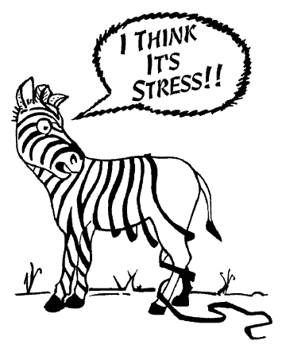
Self Care

Slide 66

Self Care
Can you eat a little healthier? Can you exercise a little more? Can you take a little more rest?
Can you find a spiritual connection?
Can you see the parts of your life that bring you joy?
Can you connect with others? Can you find ways to laugh?

Slide 67

Thank you!
Elinam Dellor,
The Ohio State University, College of Social Work
dellor.1@osu.edu

Slide 68
Race and Space (California Endowment)
Video

