Slide 1

Ohio Office of First Responder
Wellness
Steven M. Click, Director
Ohio Office of First Responder Wellness
Ohio Department of Public Safety
Office of Law Enforcement Initiatives

Slide 2
First Responder Wellness
  Created in July of 2021
  Mission:
  To create a bridge between mental health and first responders and their agencies
  Provide training for agencies and their personnel
  Serve as a reference for Ohio First Responder agencies and governmental officials / agencies

Slide 3
First Responder Wellness
  We work with:
  Law Enforcement
  Fire / EMS
  Dispatch / Communications
  Corrections
  Military
  Addiction & Mental Health Boards

Slide 4

Training Opportunities
  Crisis Awareness
  (with Addiction Awareness)
  Discusses the possible physical, mental, emotional reactions to a critical or traumatic incident or the cumulative effects of these incidents
  Provides techniques and skills to effectively deal with the effects of trauma in healthy and safe ways
  Addiction Awareness (Optional) provides an awareness level of addiction, with focus on alcohol but also addressing process and other addictions

Slide 5
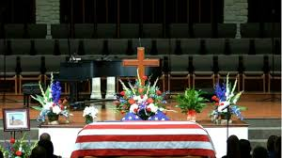
Training Opportunities
  “After the Call”
  Beneficial for all levels of public safety agencies
  Discusses what to do in the aftermath of the loss of a co-worker
    Line of Duty
    Accidental
    Suicide
  Not a “what to do” but begins the conversation for the command staff to develop plans that can be used when emotion and stress are at their highest levels

Slide 6

Training Opportunities
  Suicide Awareness
  QPR Course
  Question, Persuade and Refer
  Trains “Gatekeepers” who have the training and resources to assist co-workers, friends, family and the public
As a QPR-trained Gatekeeper you will learn to:
Recognize the warning signs of suicide
Know how to offer hope
Know how to get help and save a life

Slide 7

Training Opportunities
  Self-Care
  Discussion about need for first-responders to take care of themselves
  Techniques and strategies for self-care
  Applicable to all levels of public safety agencies

Slide 8
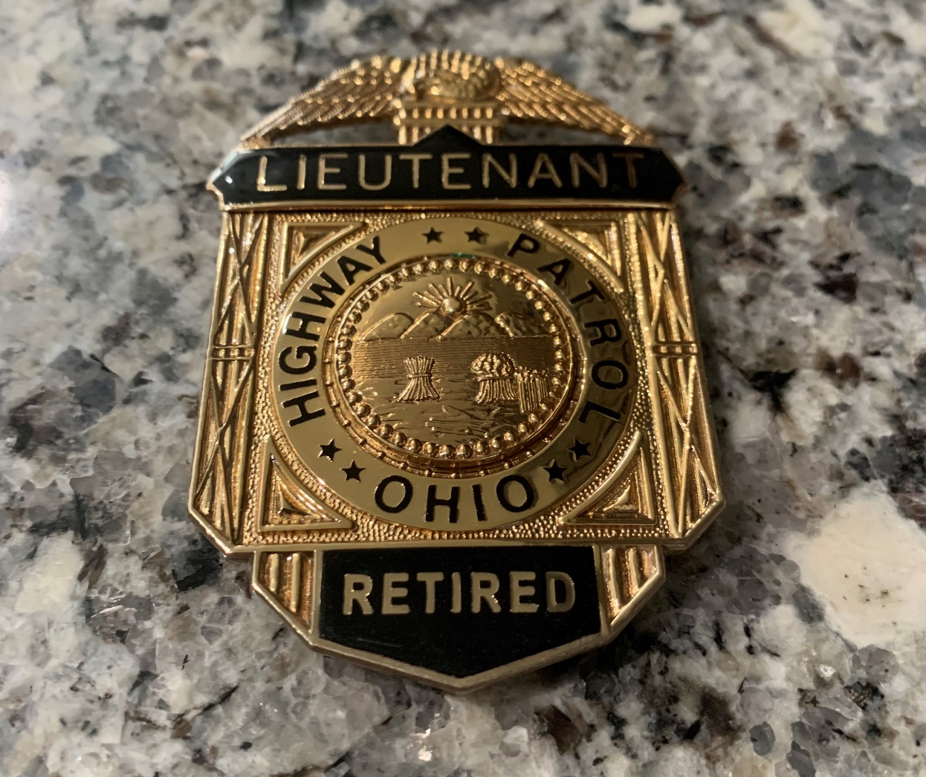
Training Opportunities
  Retirement; Surviving being a member of the Survivor’s Club
  Planning for personnel preparing to retire or newly retired
  Discusses making the transition from First Responders to retiree

Slide 9

Current State of Planning / Preparation
Continuing to provide trainings to a variety of agencies and organizations
Continue to partner with others on mental health support for Ohio’s 92,000+ First Responders
Continue to promote partnerships between First Responder agencies and community mental health resources

Slide 10


American Rescue Plan Act (ARPA)
This bill provides additional relief to address the continued impact of COVID-19 (i.e., coronavirus disease 2019) on the economy, public health, state and local governments, individuals, and businesses.
$250 Million for the State of Ohio
$175M Designated for Violent Crime Reduction
$75M Designated for Wellness, Resilience, Recruitment & Retention
Recommended 154 applications for $13,980,255

Slide 11
Wellness Coordinators Teams Meeting
We facilitate a monthly call for wellness coordinators and others working in wellness for First Responders across the state
Currently over 300 persons on the roster
Law Enforcement, Fire Service, EMS, Dispatch, Corrections, Mental Health
Provides an opportunity to share information

Slide 12

Additional Resources

Slide 13

Contact Information
Steven M. Click, Director
Ohio Office of First Responder Wellness
Office of Law Enforcement Initiatives
1970 West Broad Street
Columbus, Ohio 43233
614-466-4470 Desk
614-949-2428 Cell
STClick@dps.ohio.gov

Slide 14


Questions……….

