Slide 1
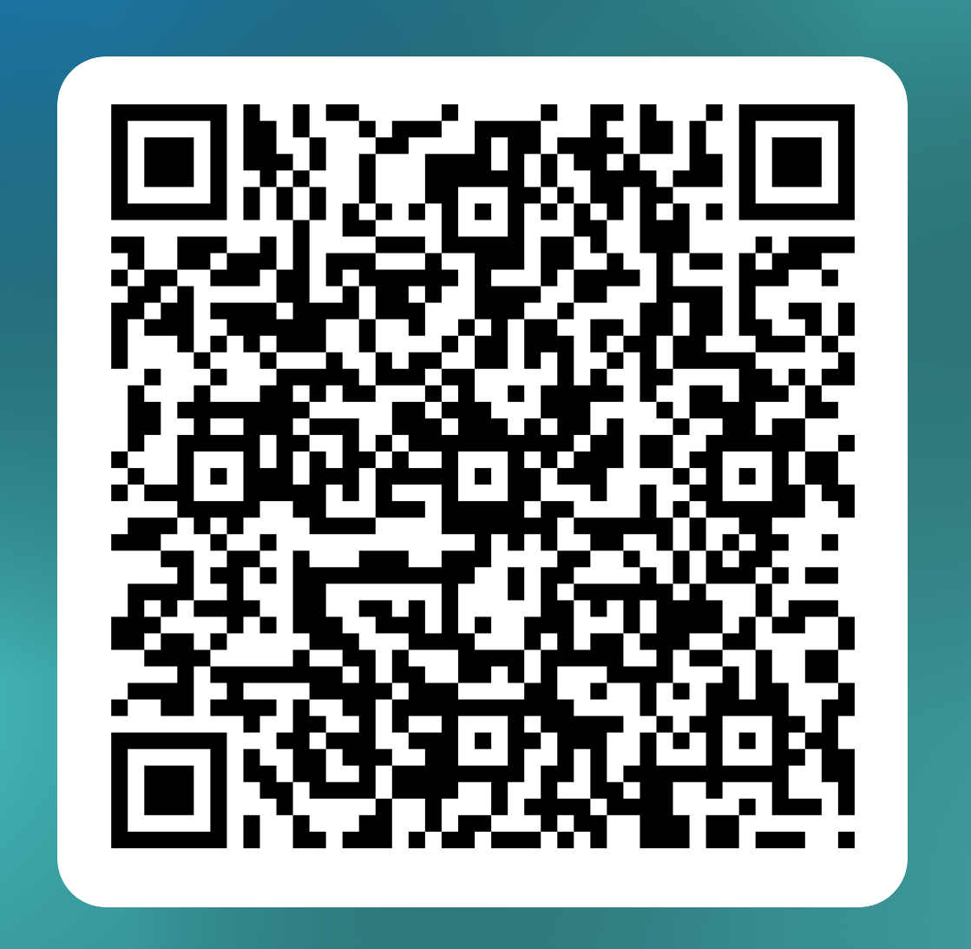
ASPIRES Center
Pilot Grant Program Summer Conference
Friday, August 22, 2025, 8:30am – 12:30pm
NCH Conference Center – Allen Auditorium A
Zoom: https://zoom.us/j/94130492902
Meeting ID: 941 3049 2902
Light Breakfast will be served.
Please scan QR Code to register.

